Slide 1

Read-aloud slides
Puppy Love
Read aloud from your book while the whole class follows the pictures on the big screen.
By Miss Rose
Free for classrooms and families. Please download your own copy from authormissrose.com/read-aloud instead of re-uploading these files. Free teaching resources: authormissrose.com/schools. © KidzManual LLC
Notes:
Read the story aloud from the printed book. Advance one slide per page turn. Each slide's notes give the page number in the book.

Slide 2
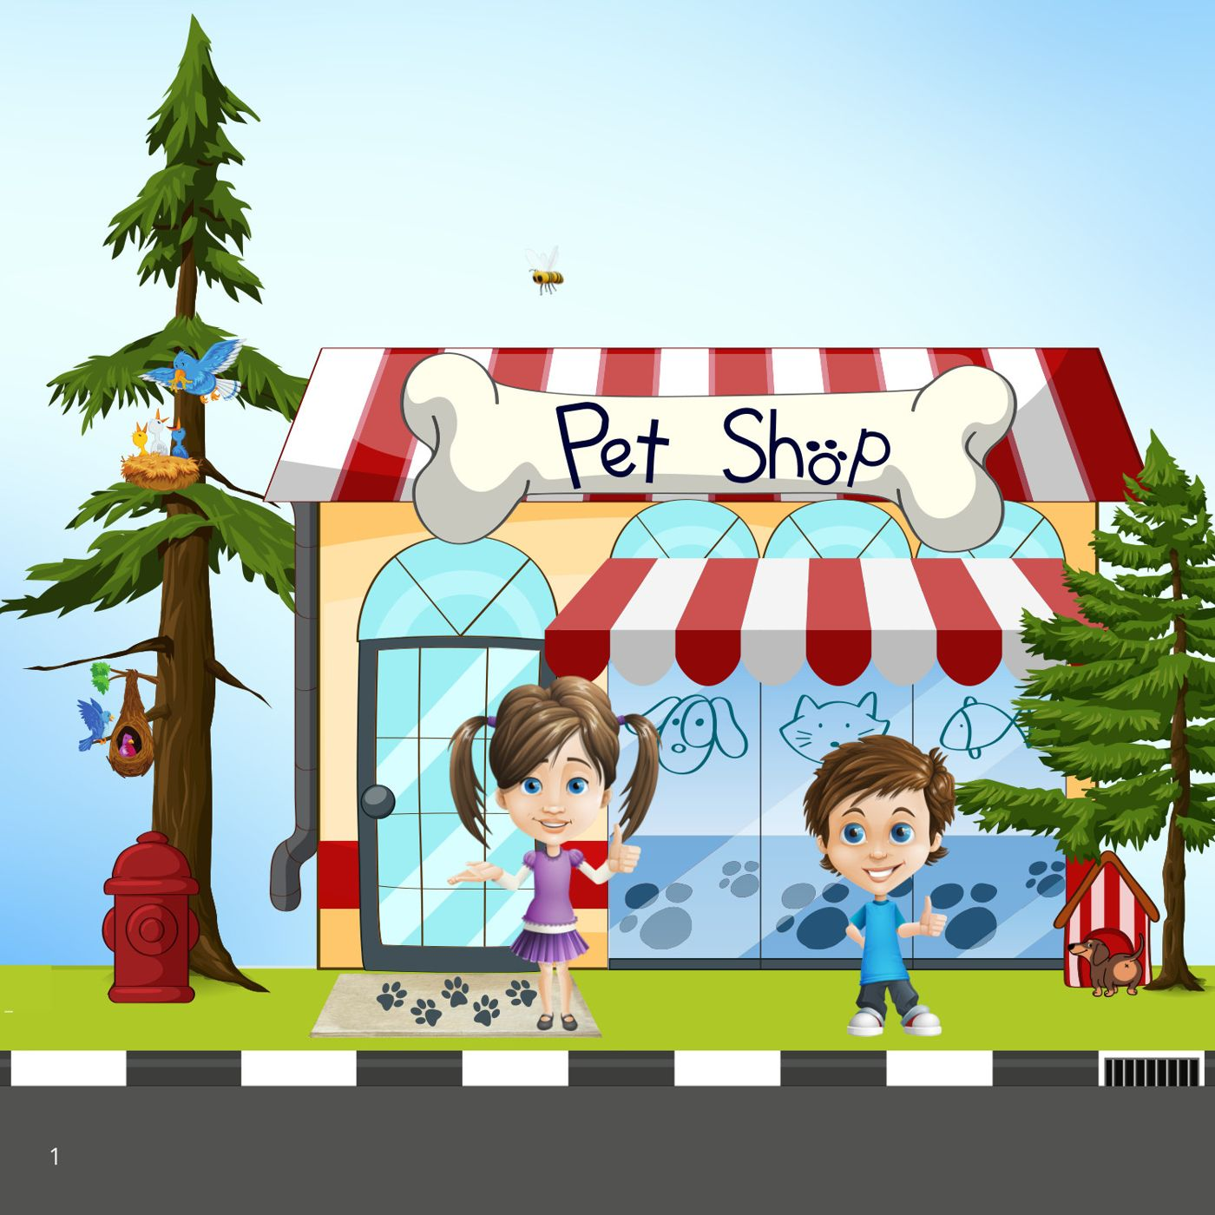
Notes:
Book page 1.

Slide 3
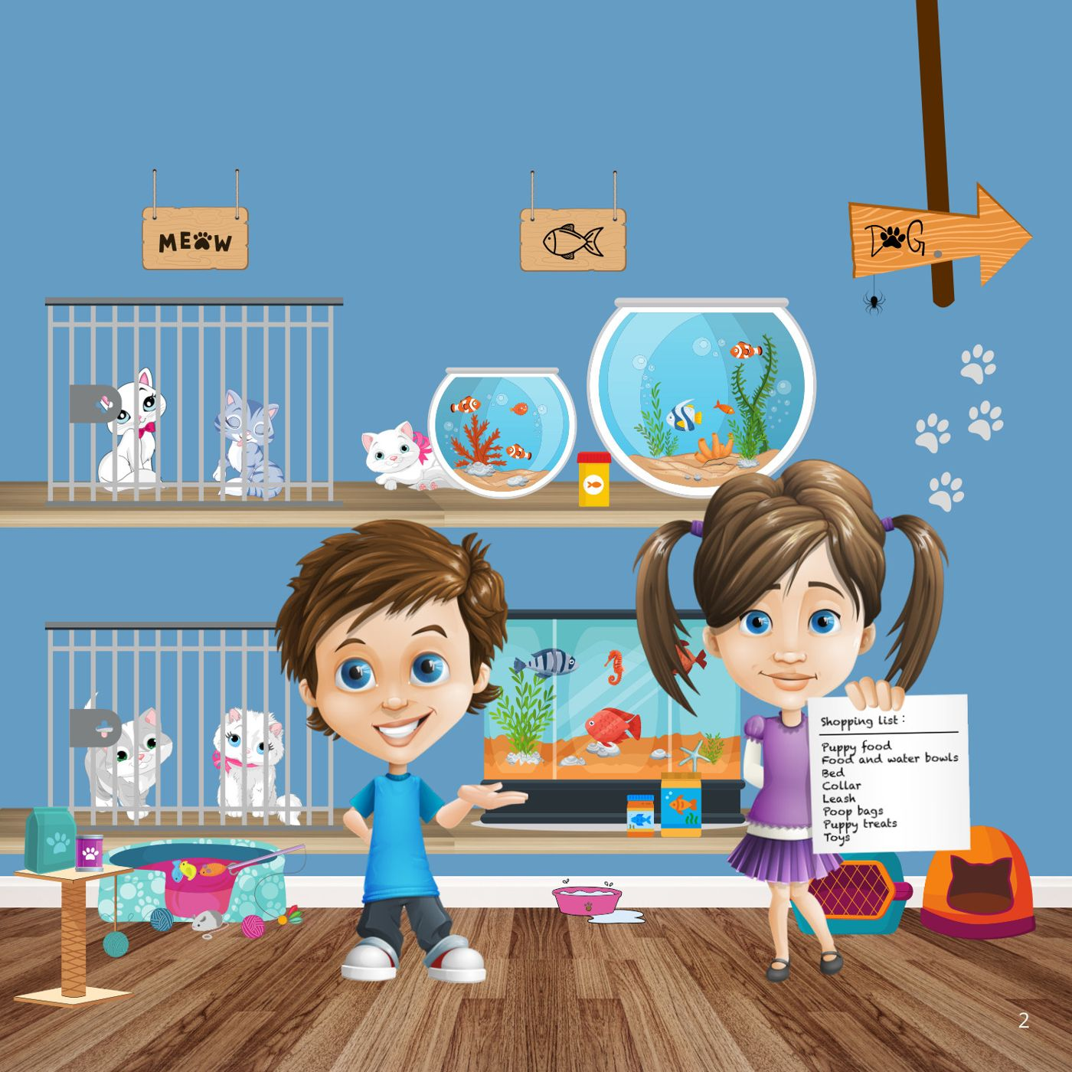
Notes:
Book page 2.

Slide 4
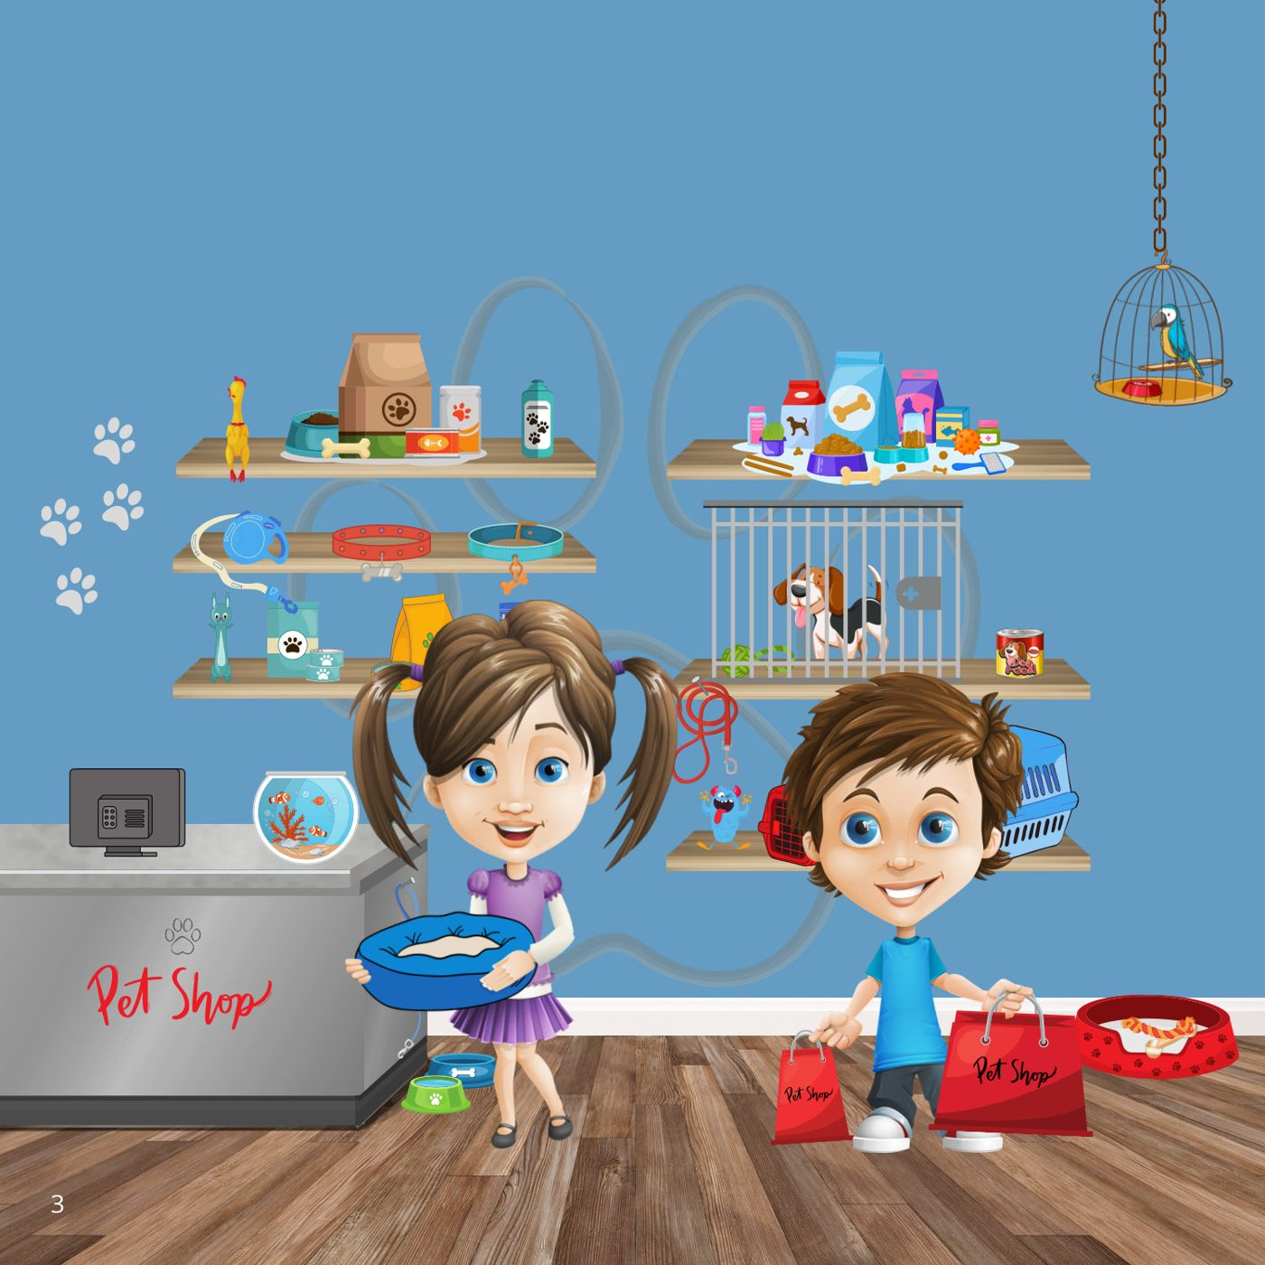
Notes:
Book page 3.

Slide 5
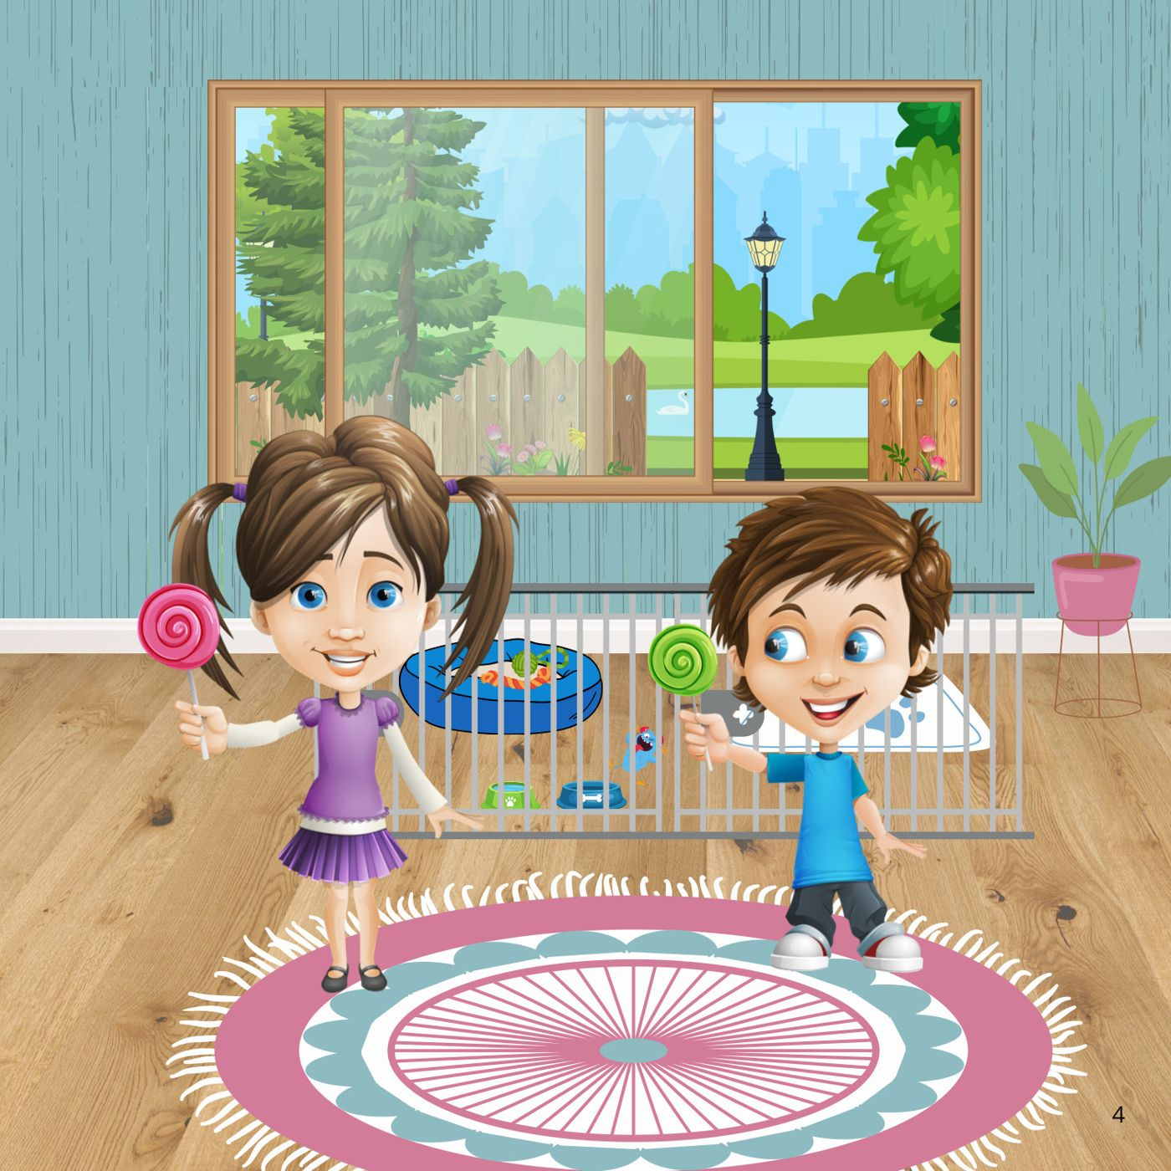
Notes:
Book page 4.

Slide 6
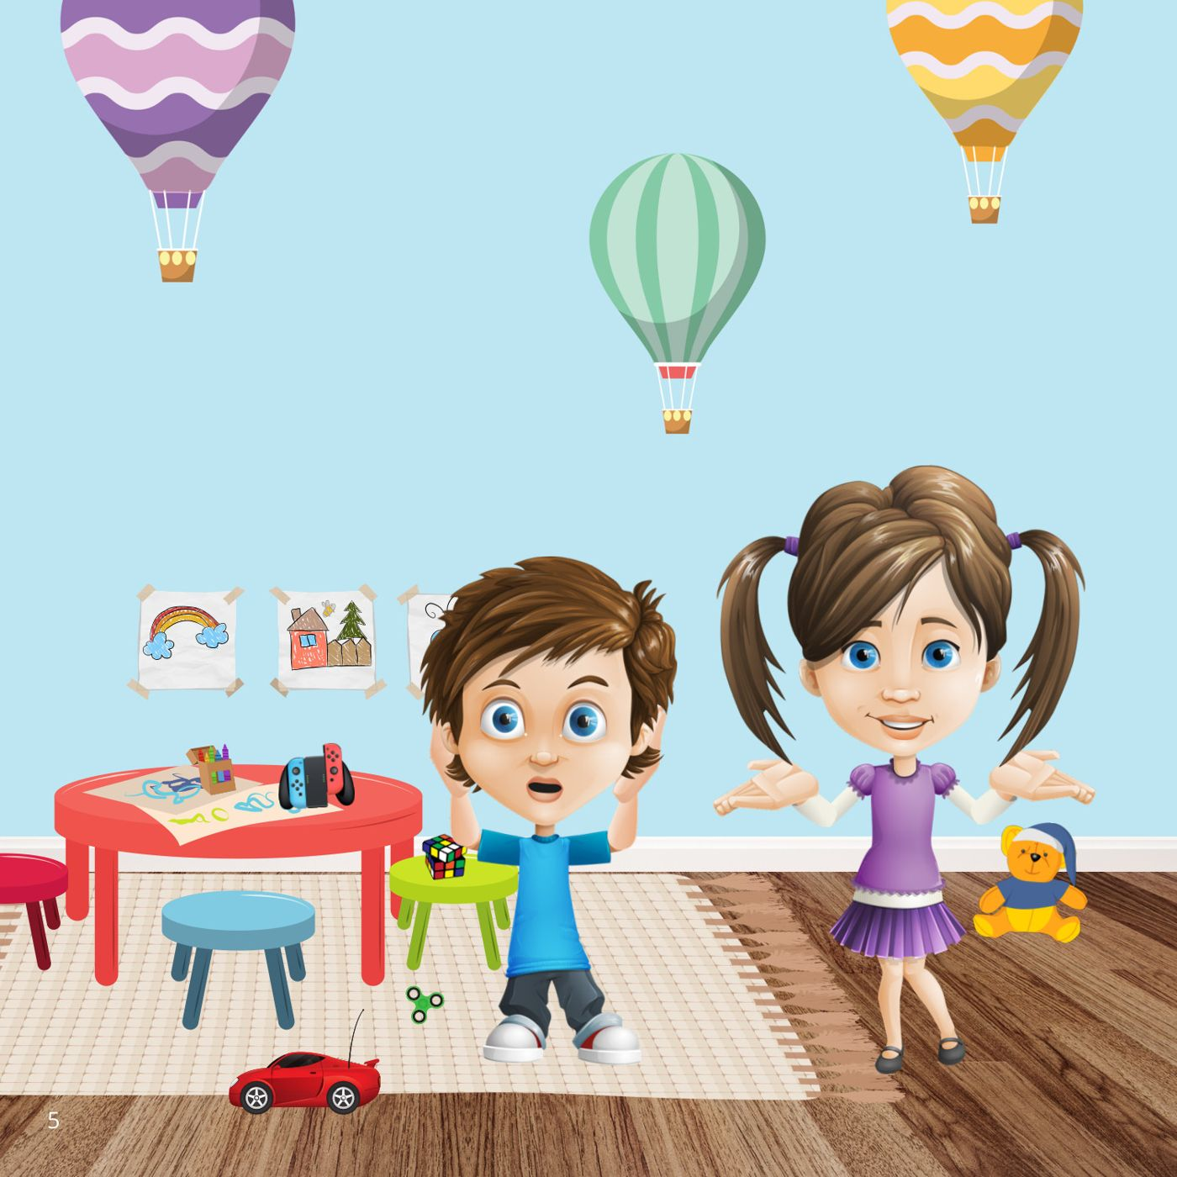
Notes:
Book page 5.

Slide 7
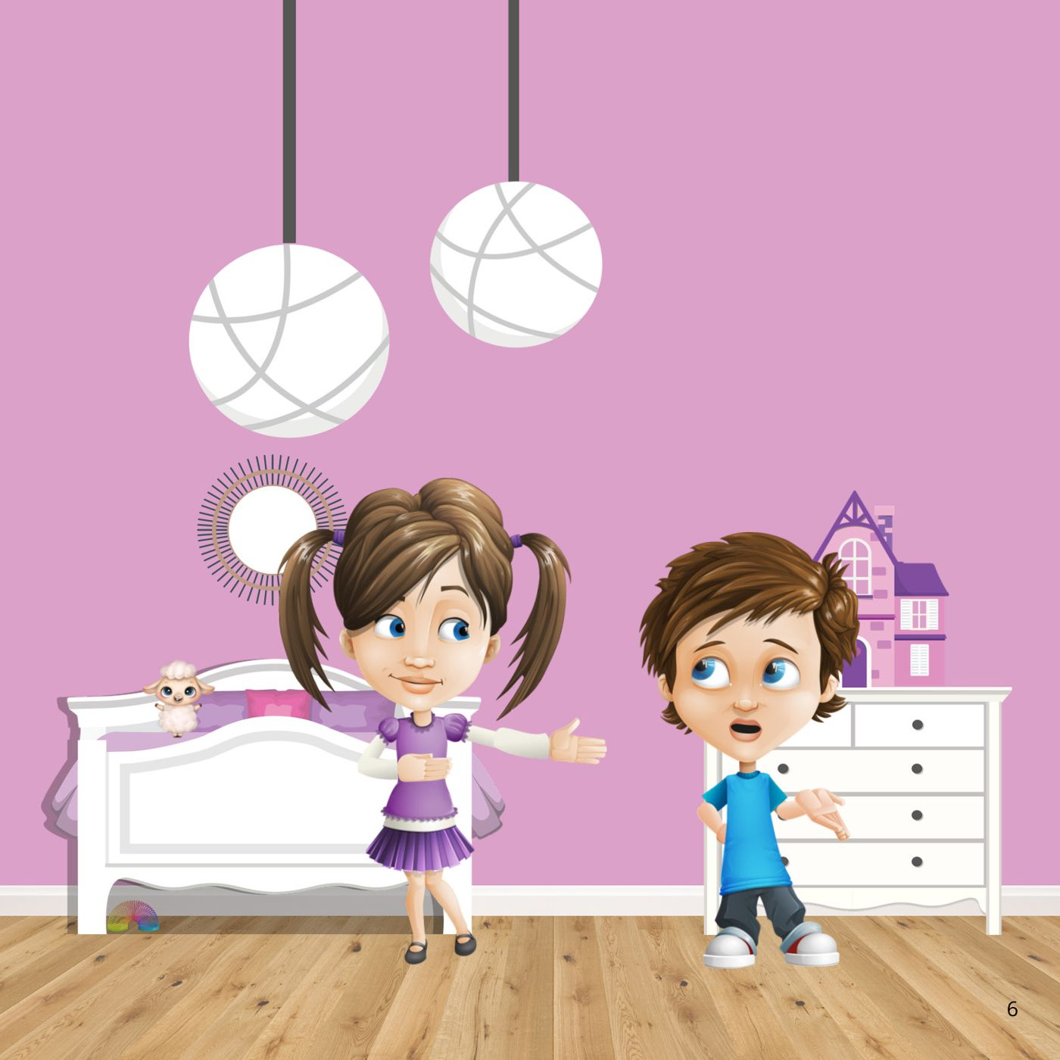
Notes:
Book page 6.

Slide 8

Notes:
Book page 7.

Slide 9
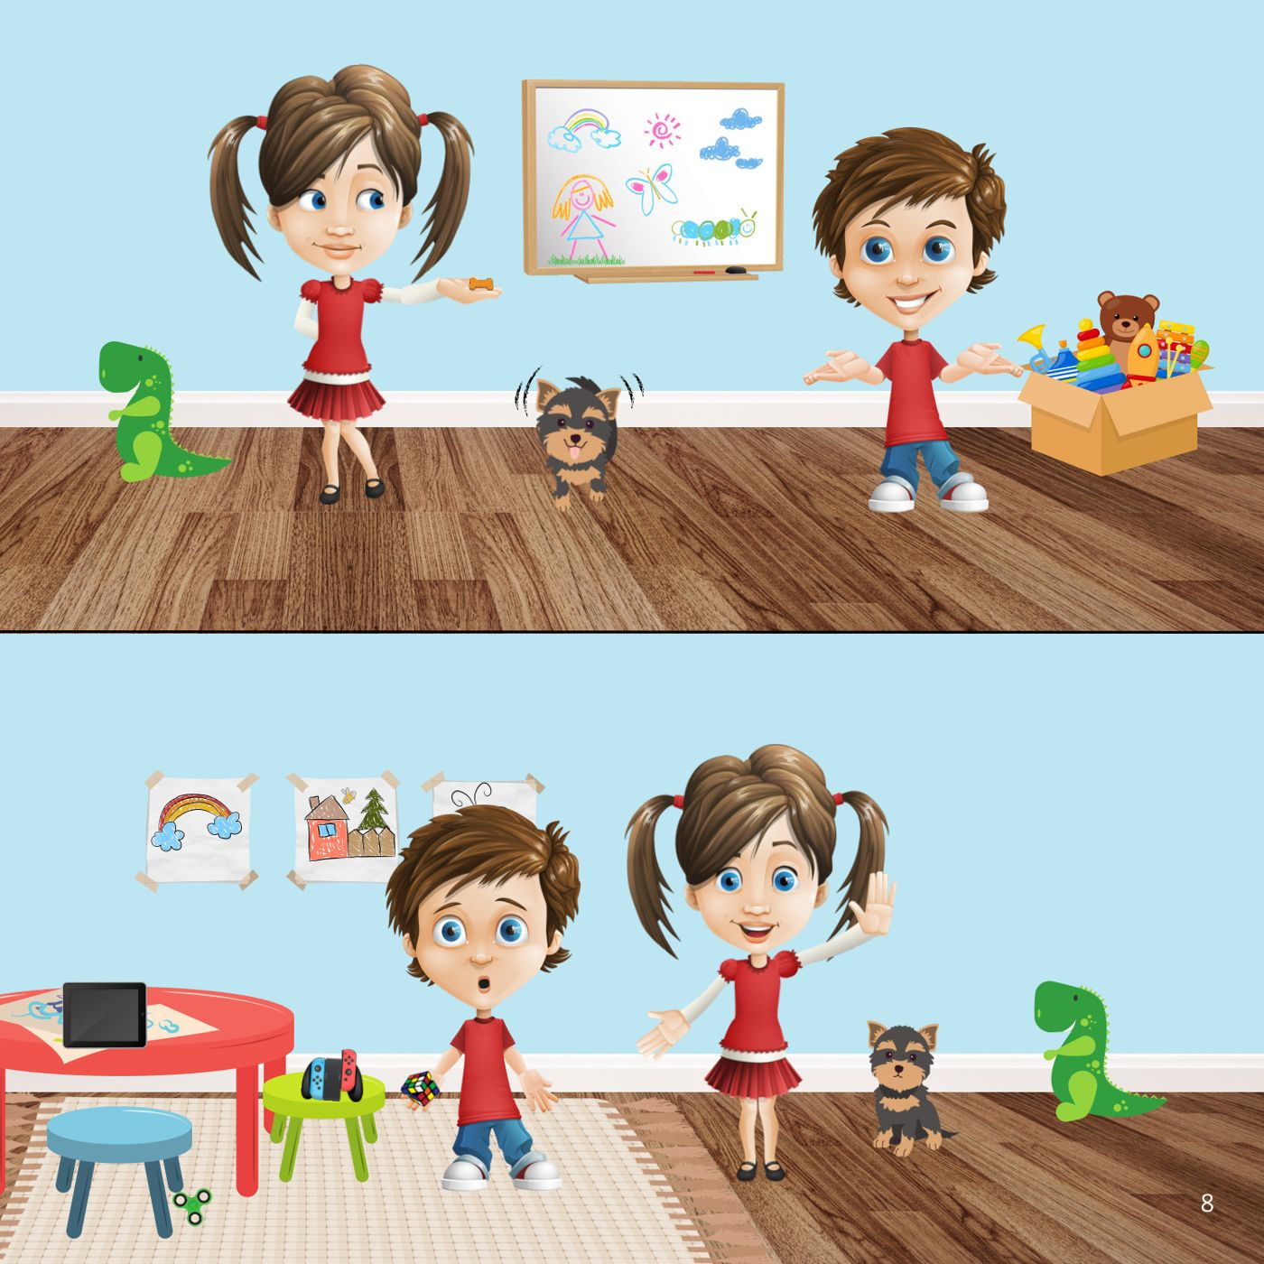
Notes:
Book page 8.

Slide 10
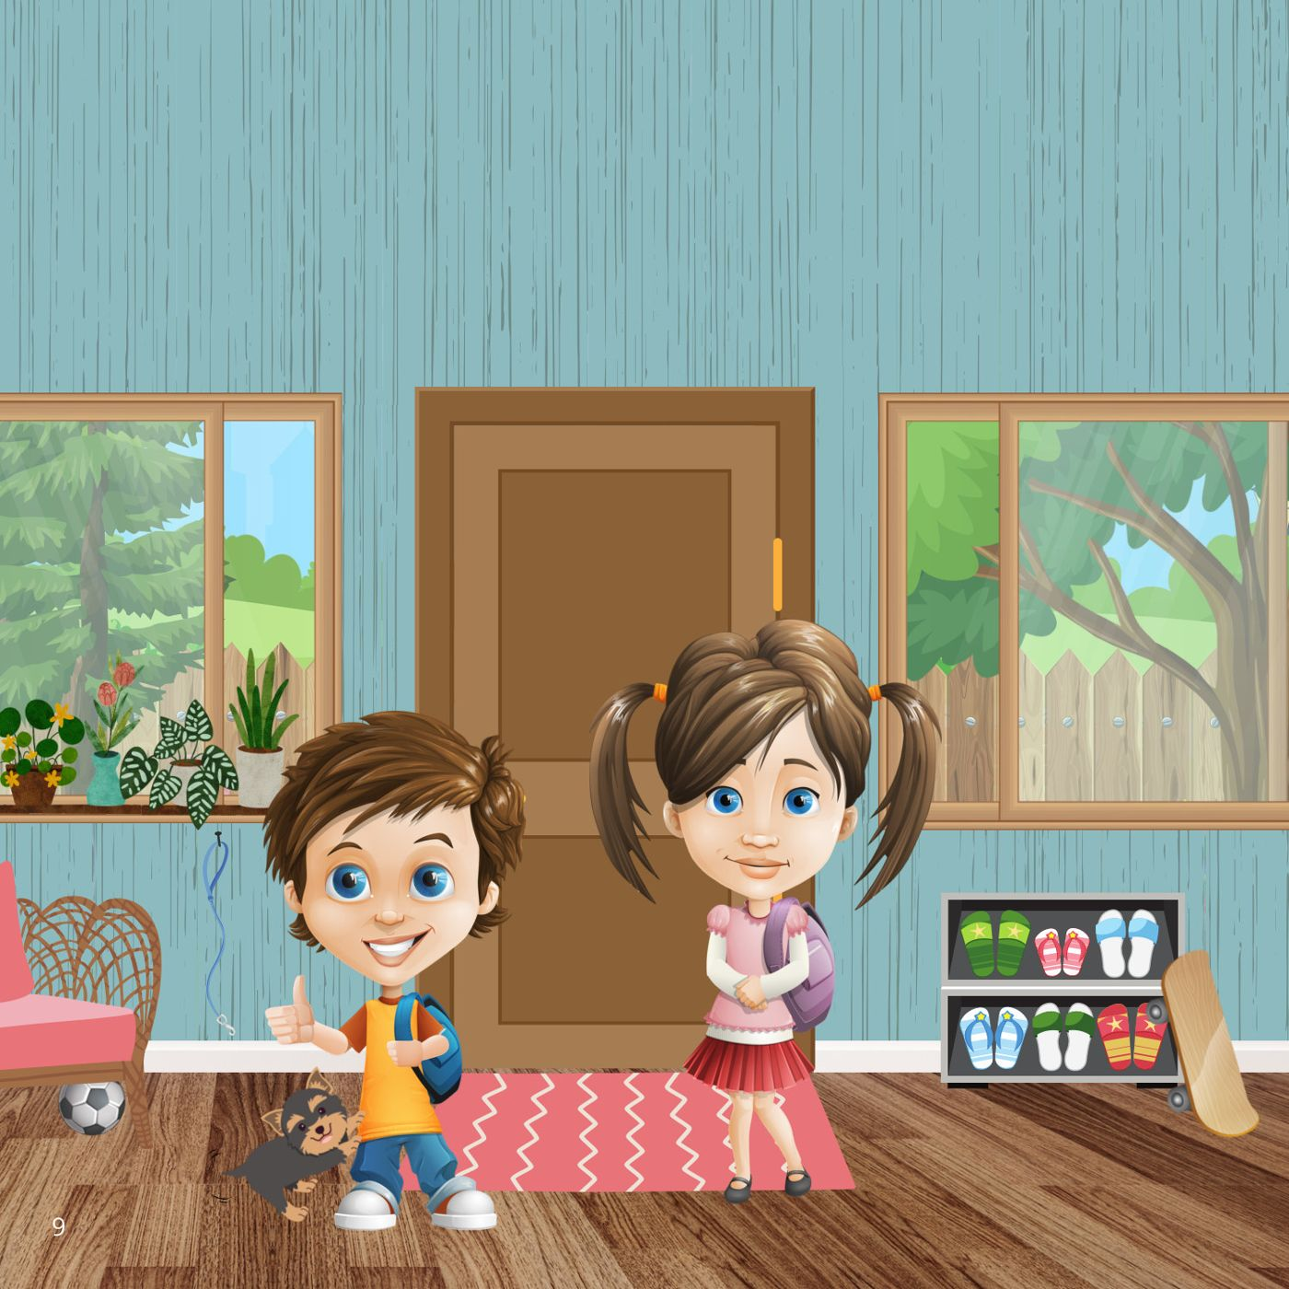
Notes:
Book page 9.

Slide 11
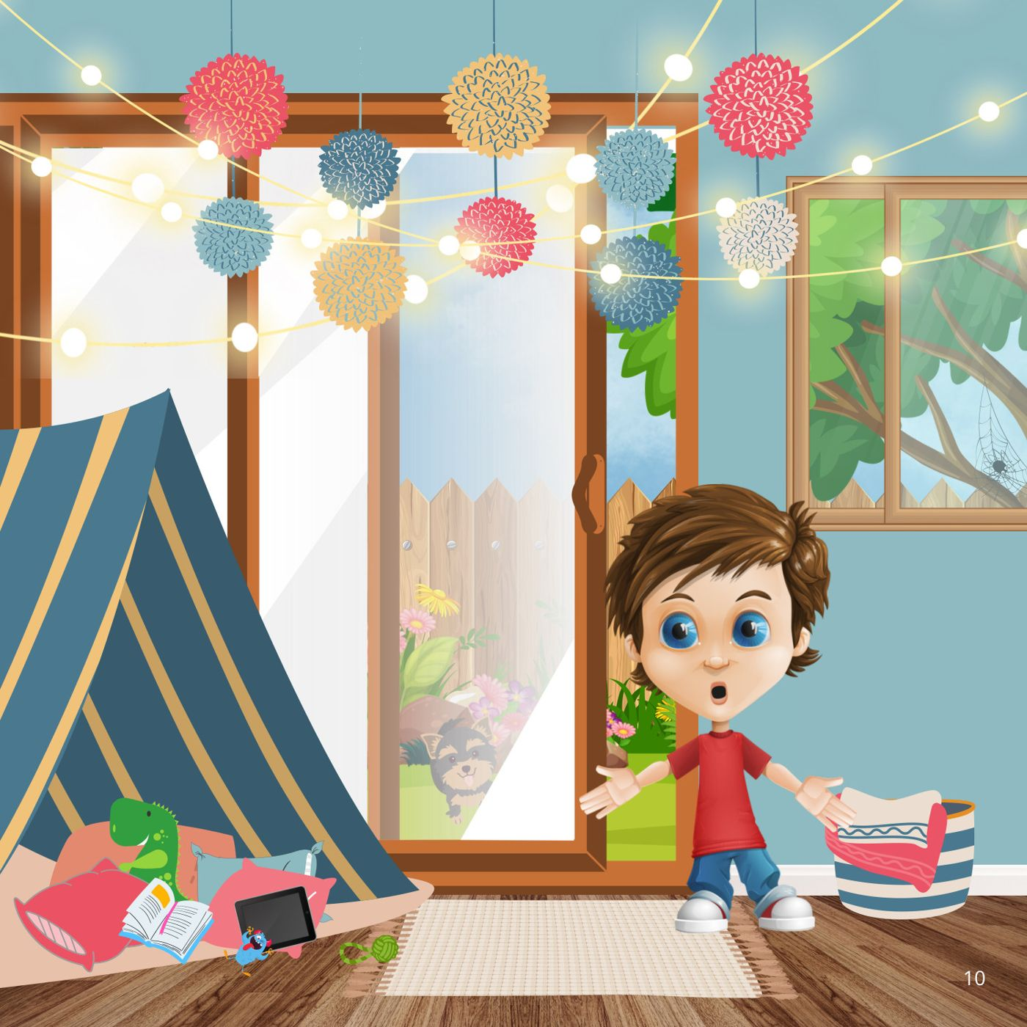
Notes:
Book page 10.

Slide 12
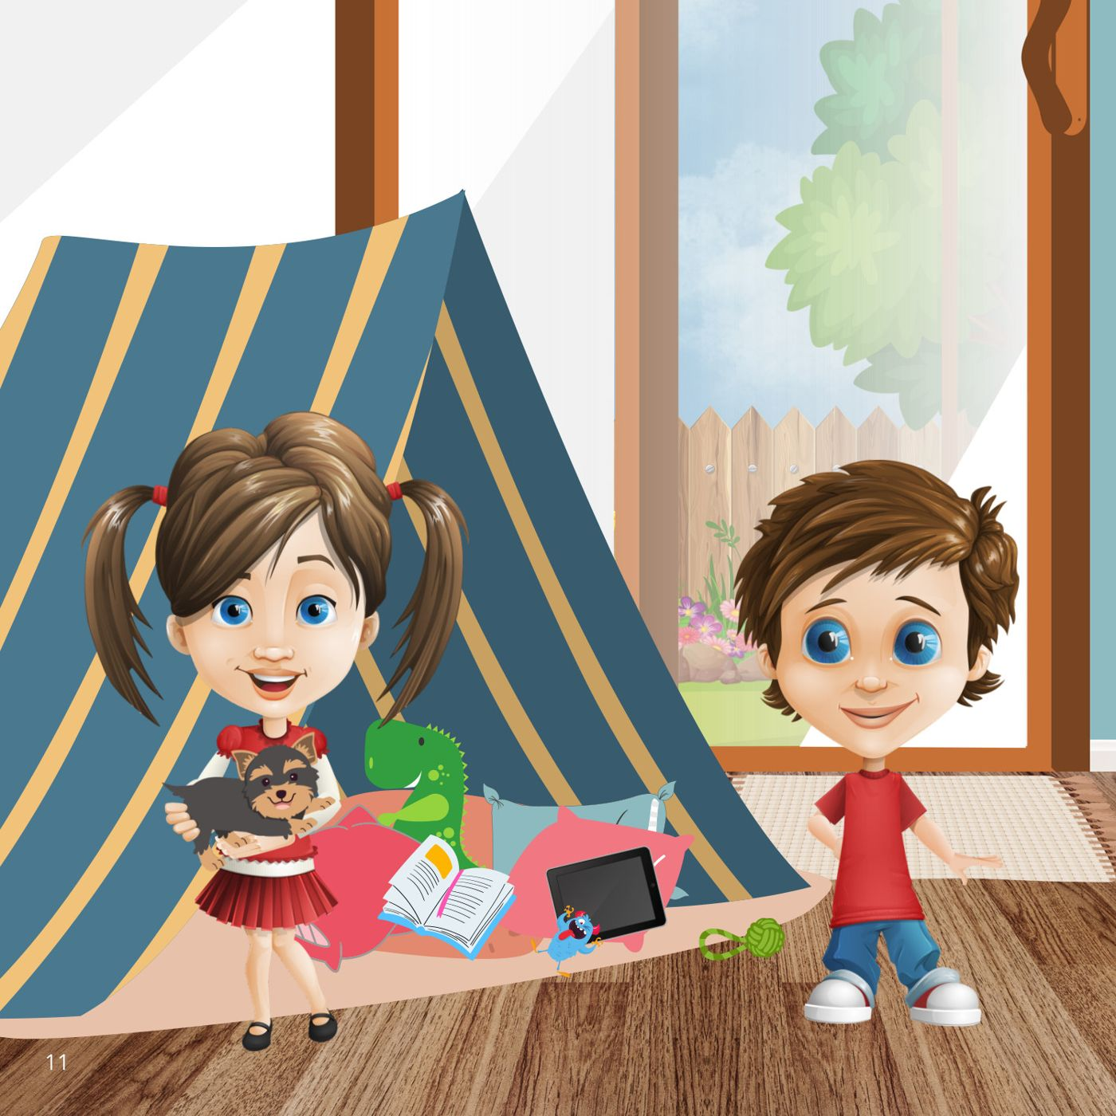
Notes:
Book page 11.

Slide 13
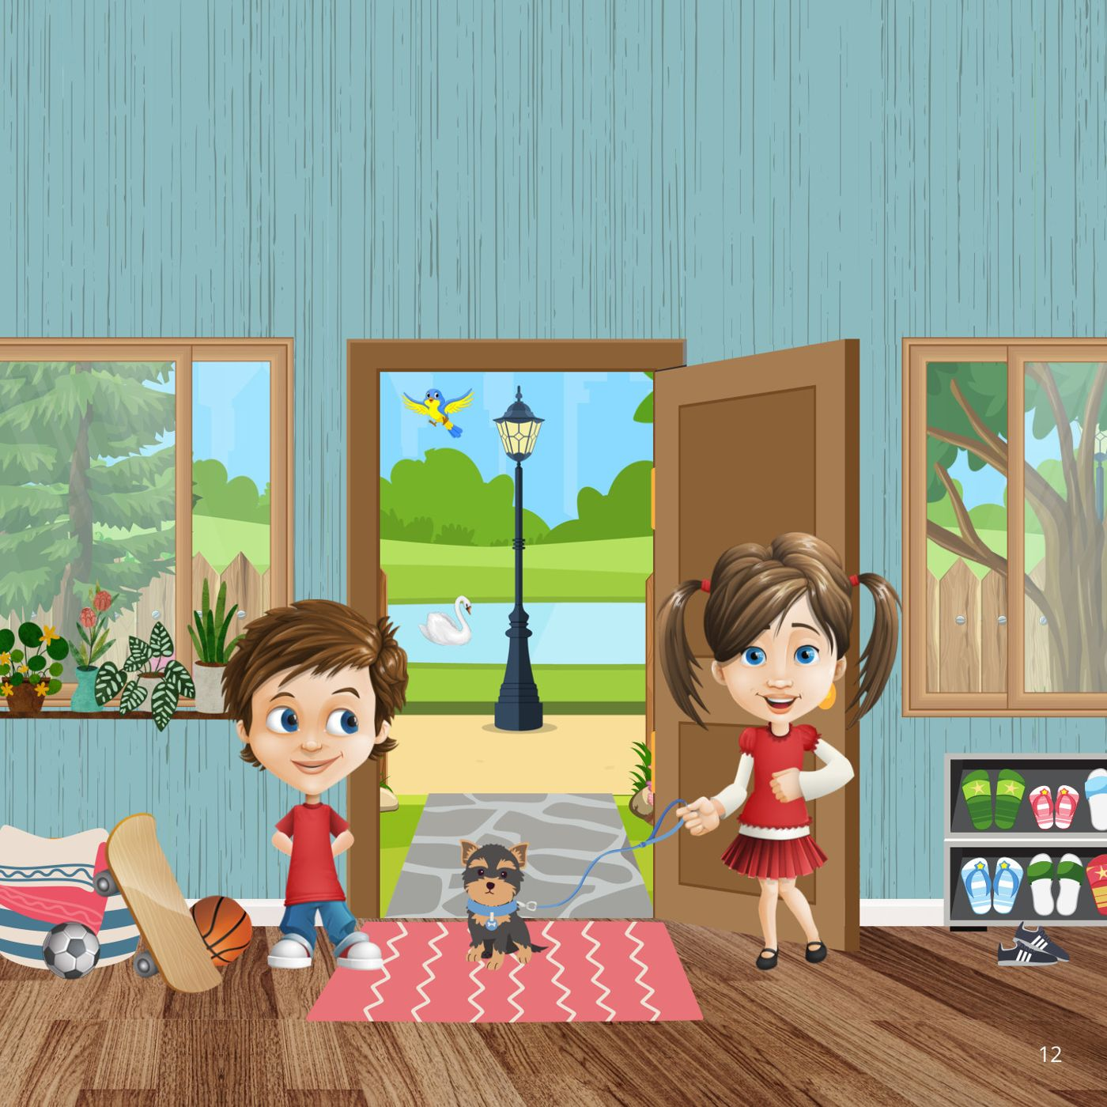
Notes:
Book page 12.

Slide 14
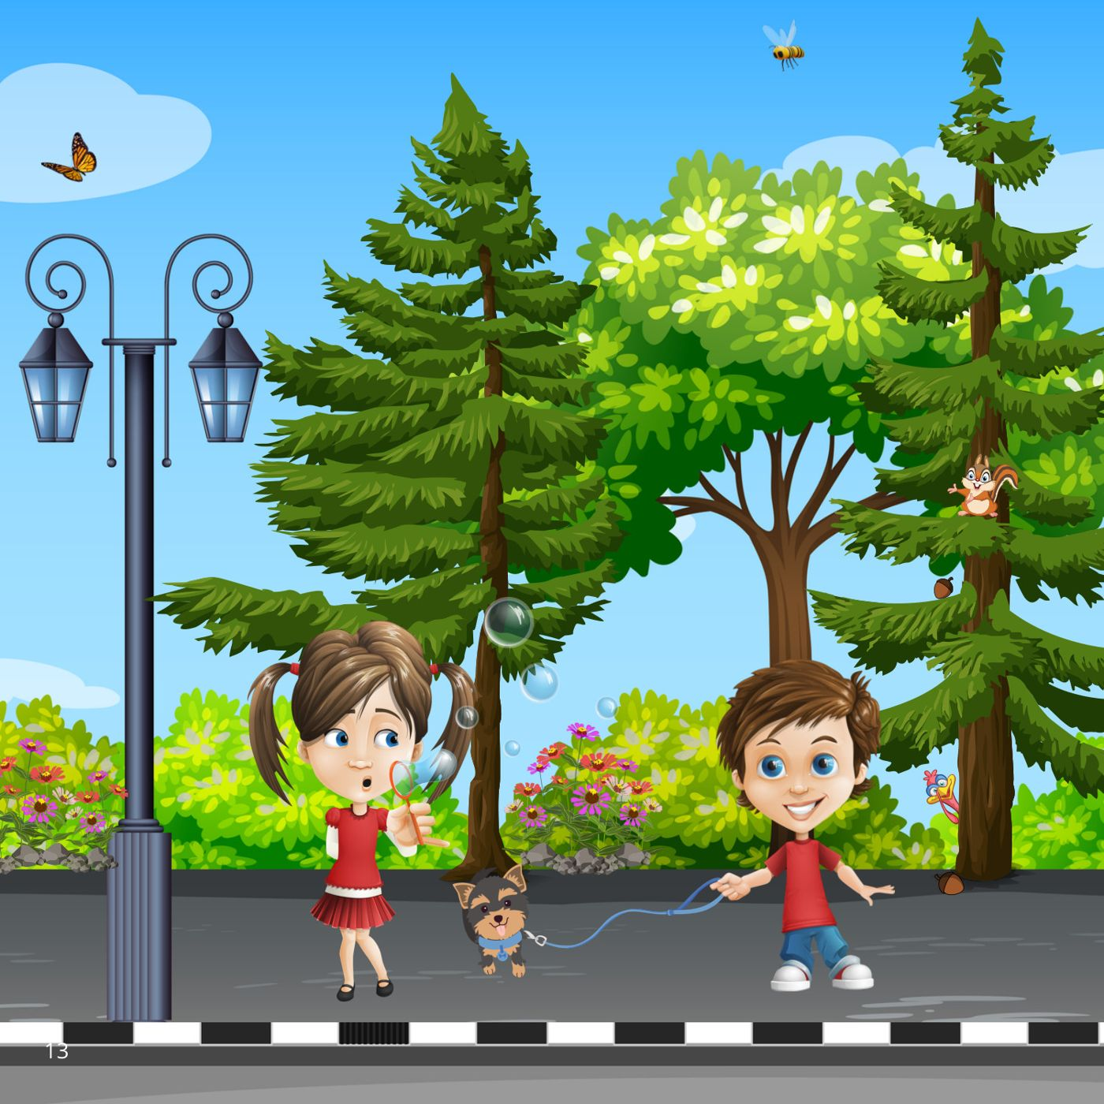
Notes:
Book page 13.

Slide 15
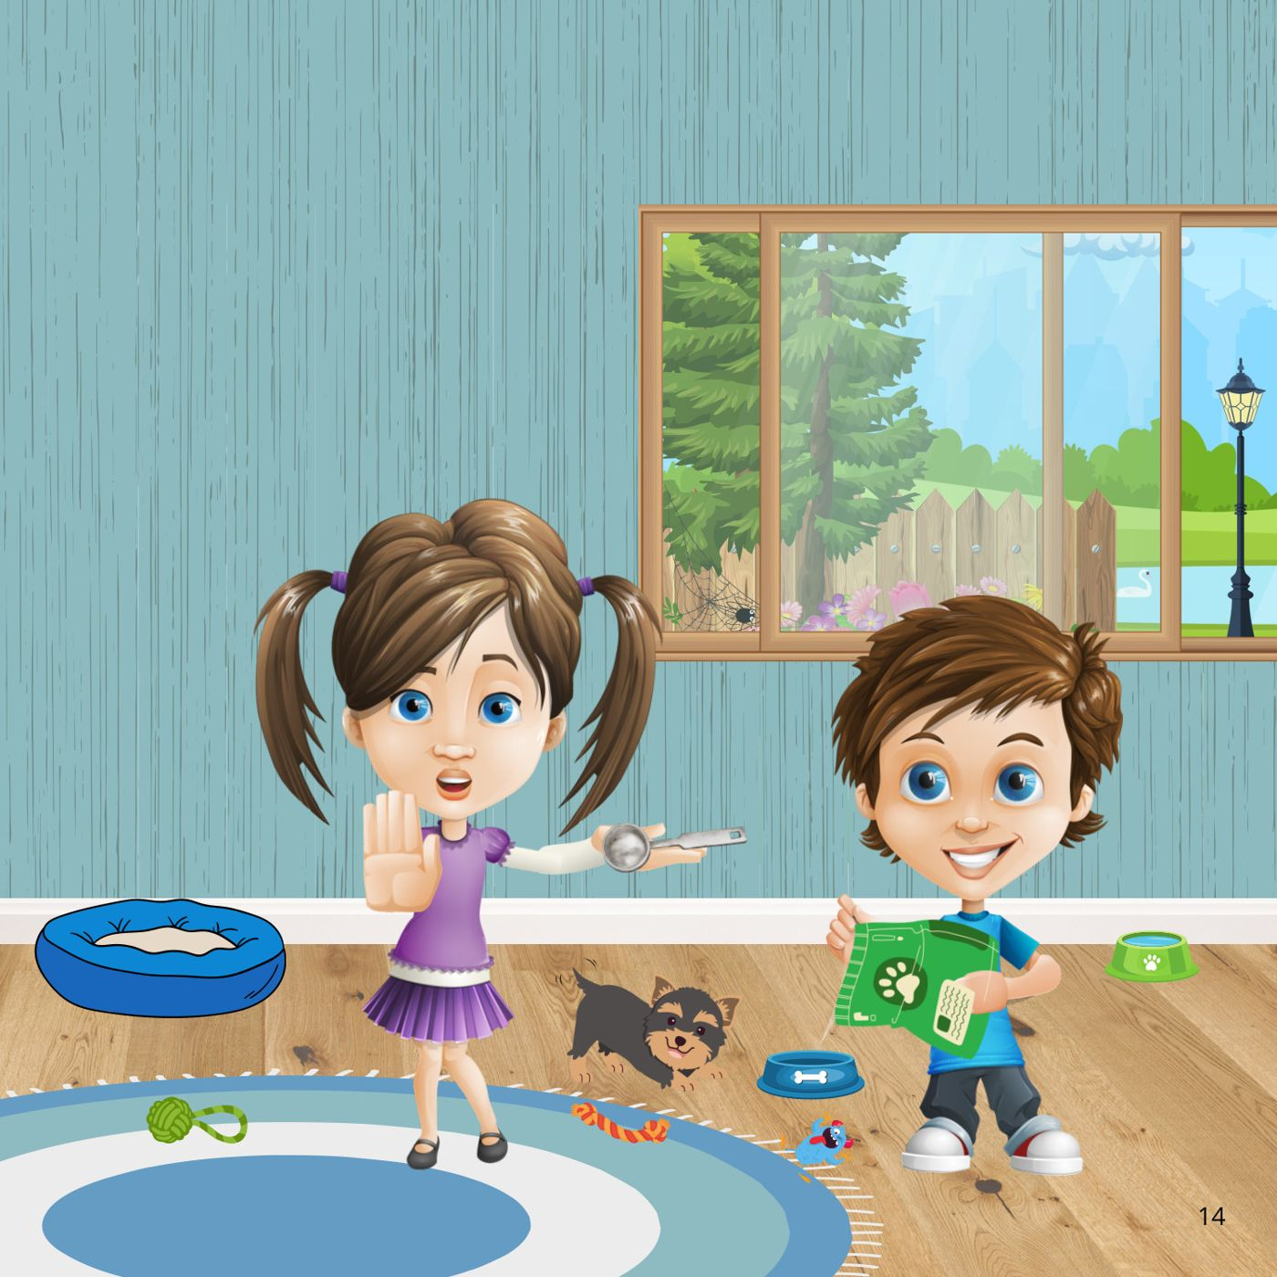
Notes:
Book page 14.

Slide 16
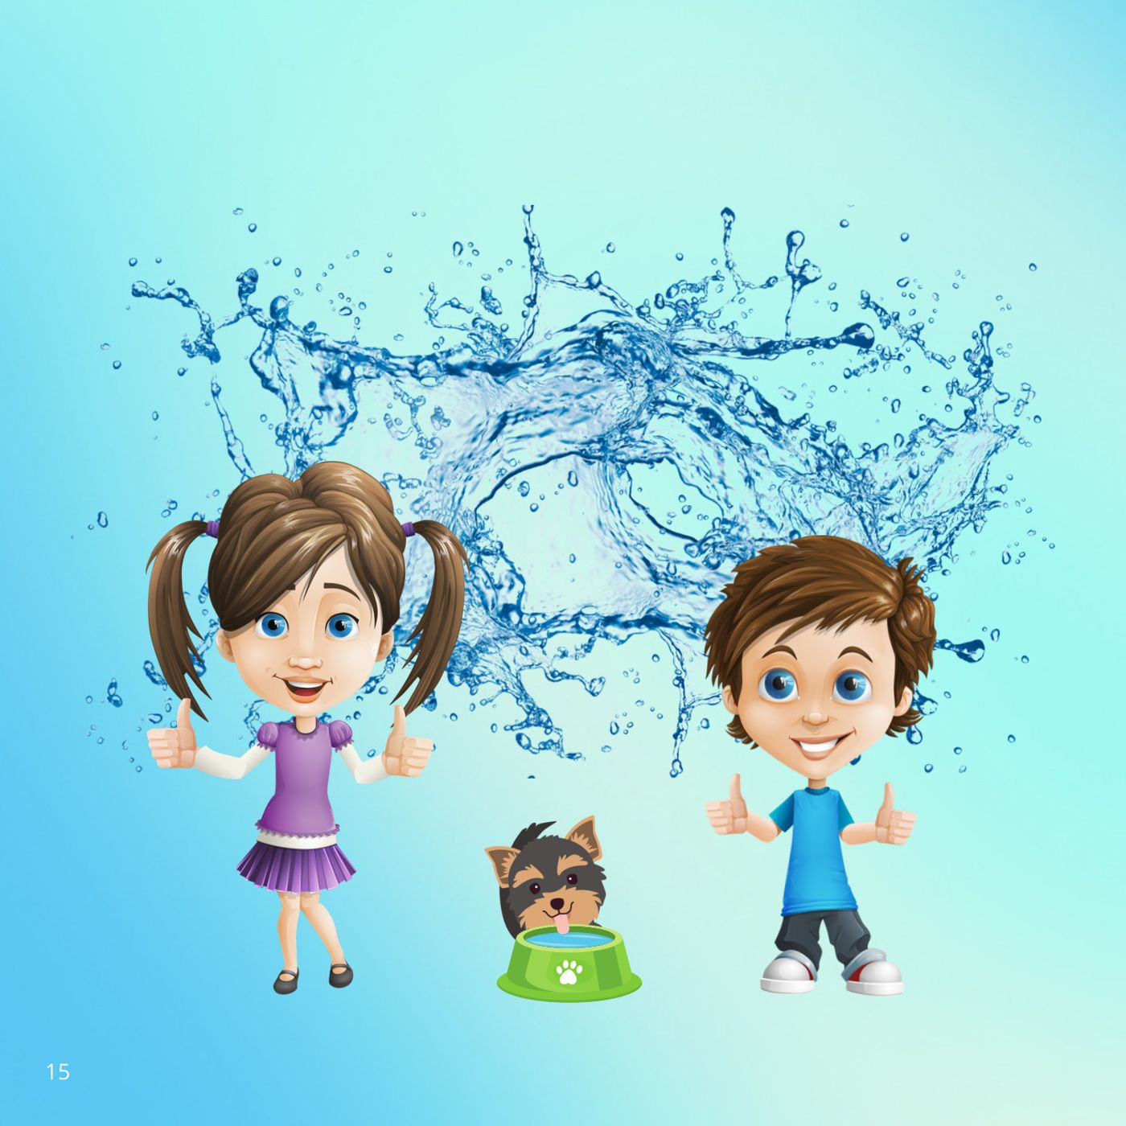
Notes:
Book page 15.

Slide 17
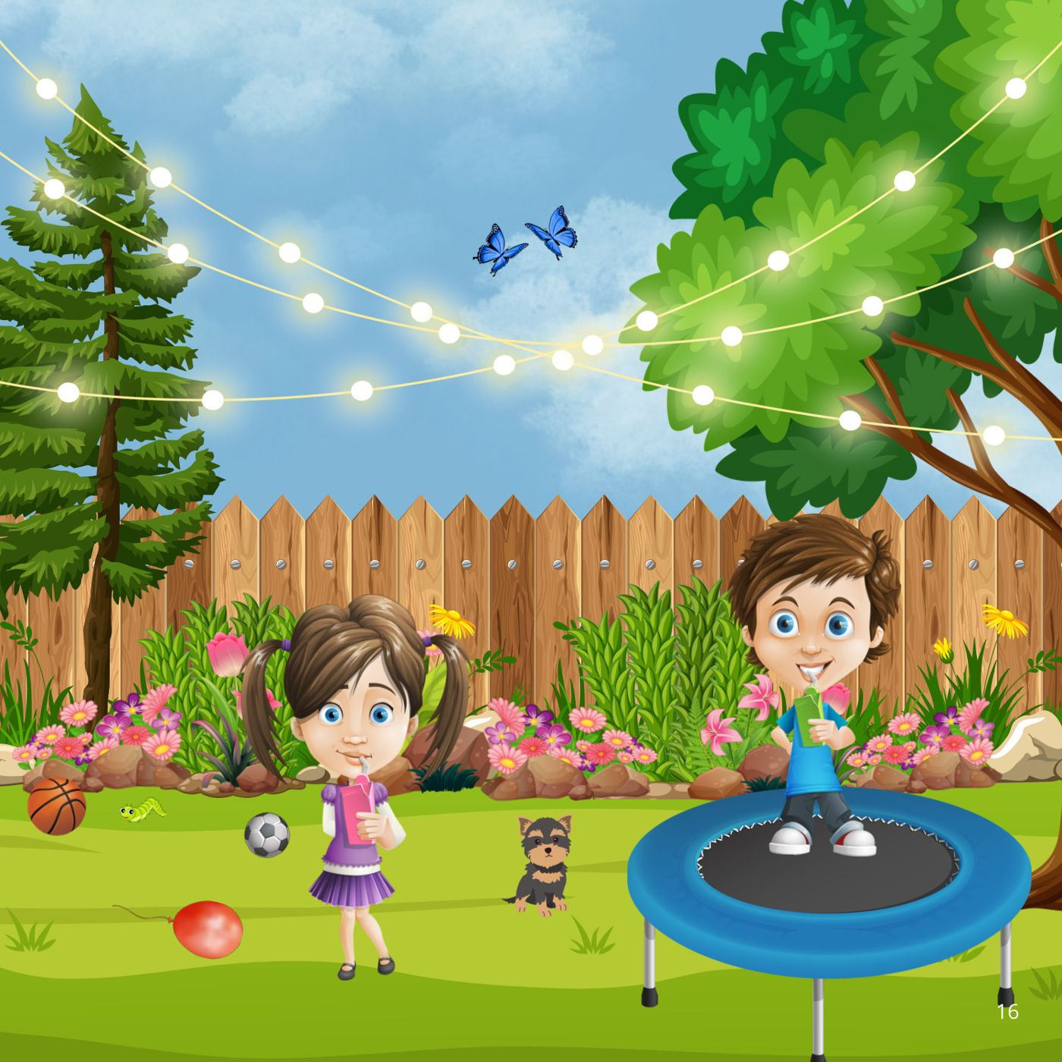
Notes:
Book page 16.

Slide 18
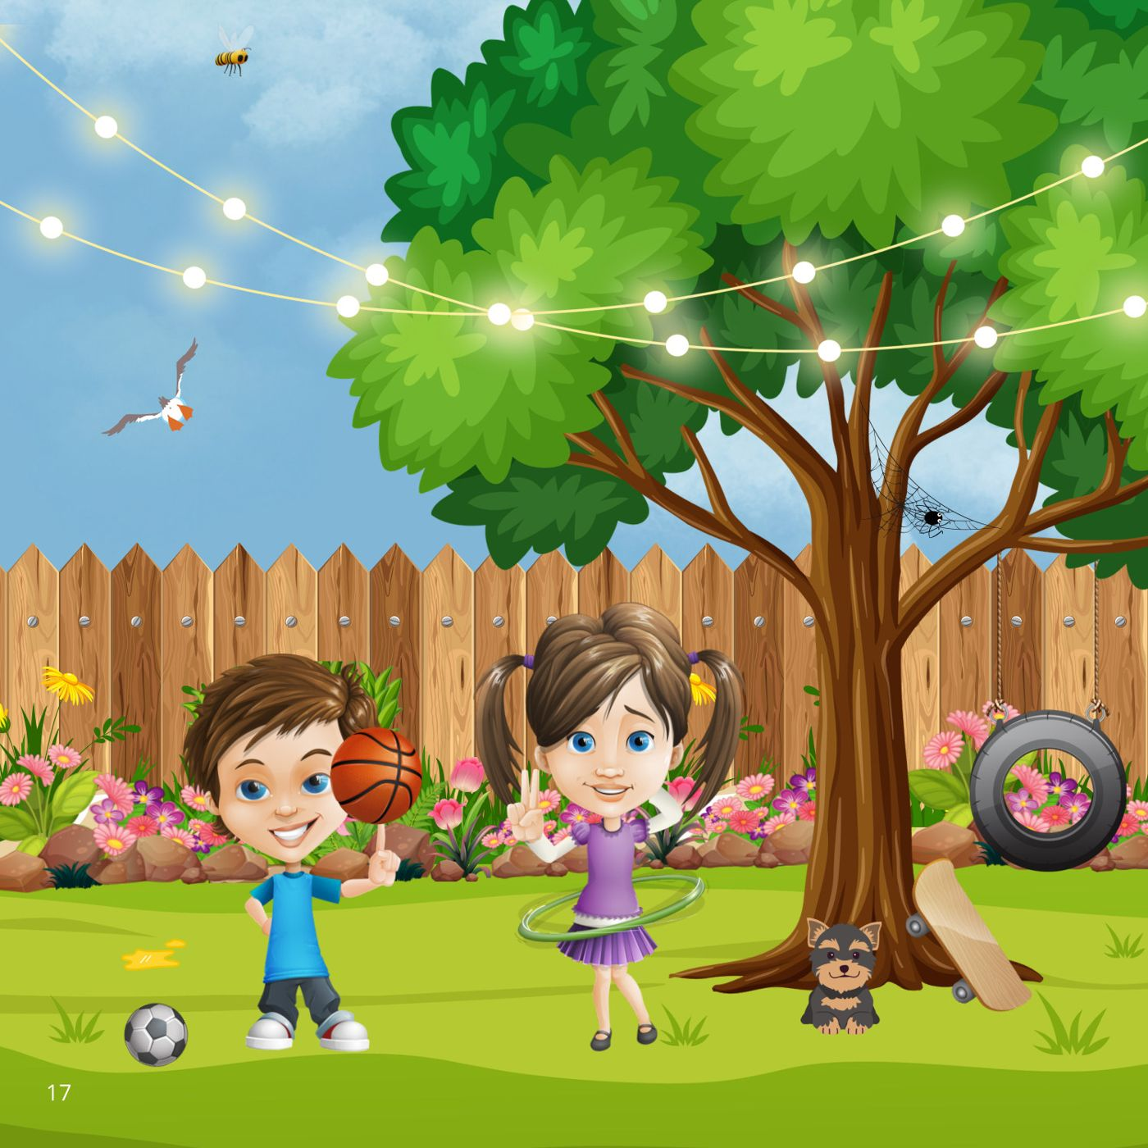
Notes:
Book page 17.

Slide 19
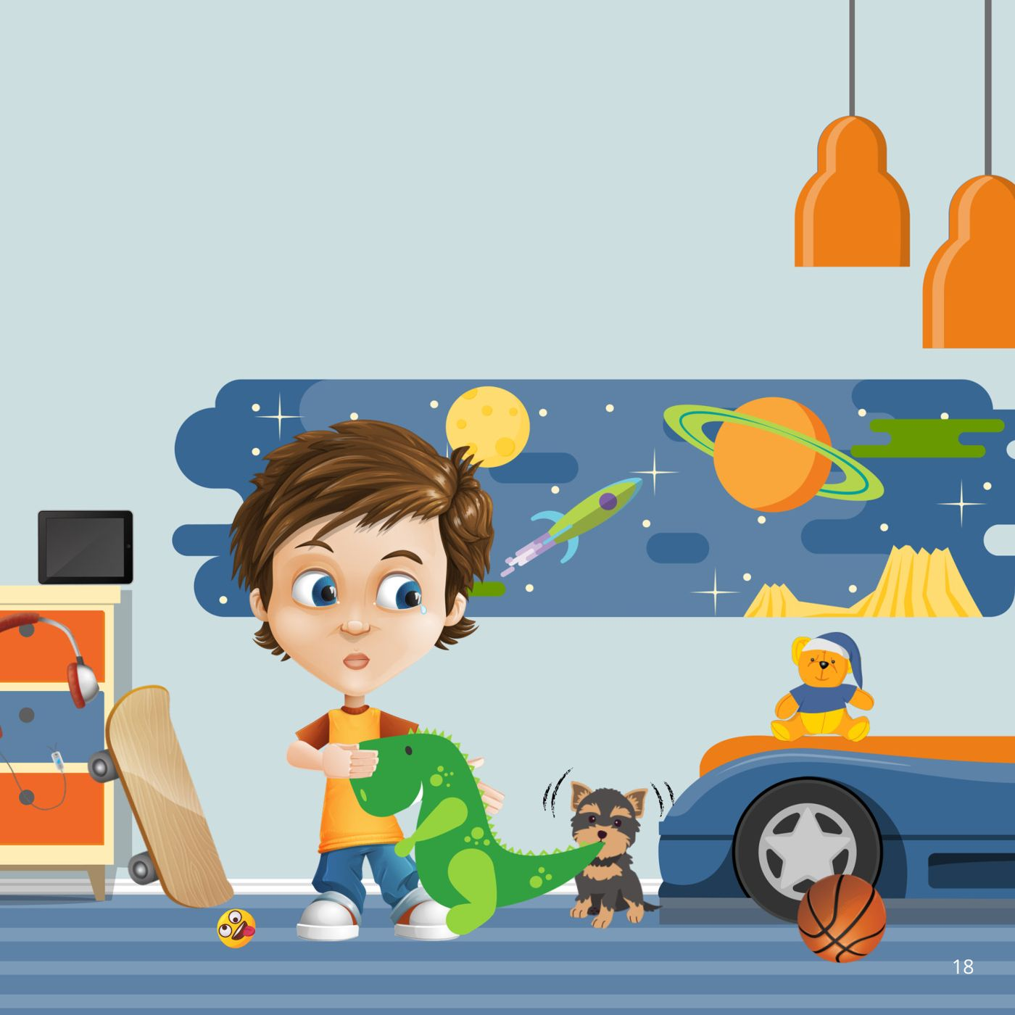
Notes:
Book page 18.

Slide 20
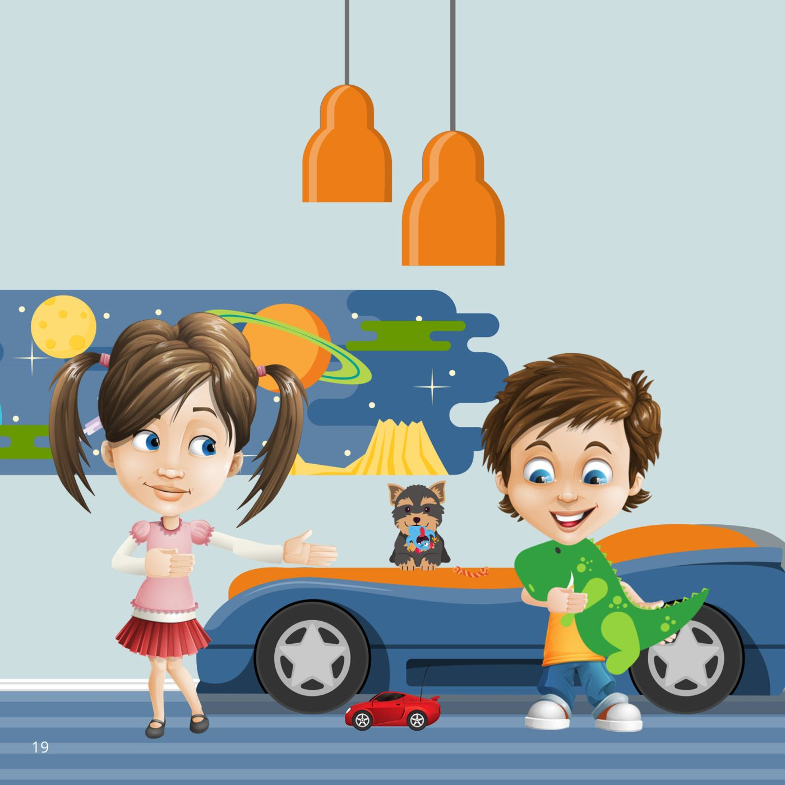
Notes:
Book page 19.

Slide 21
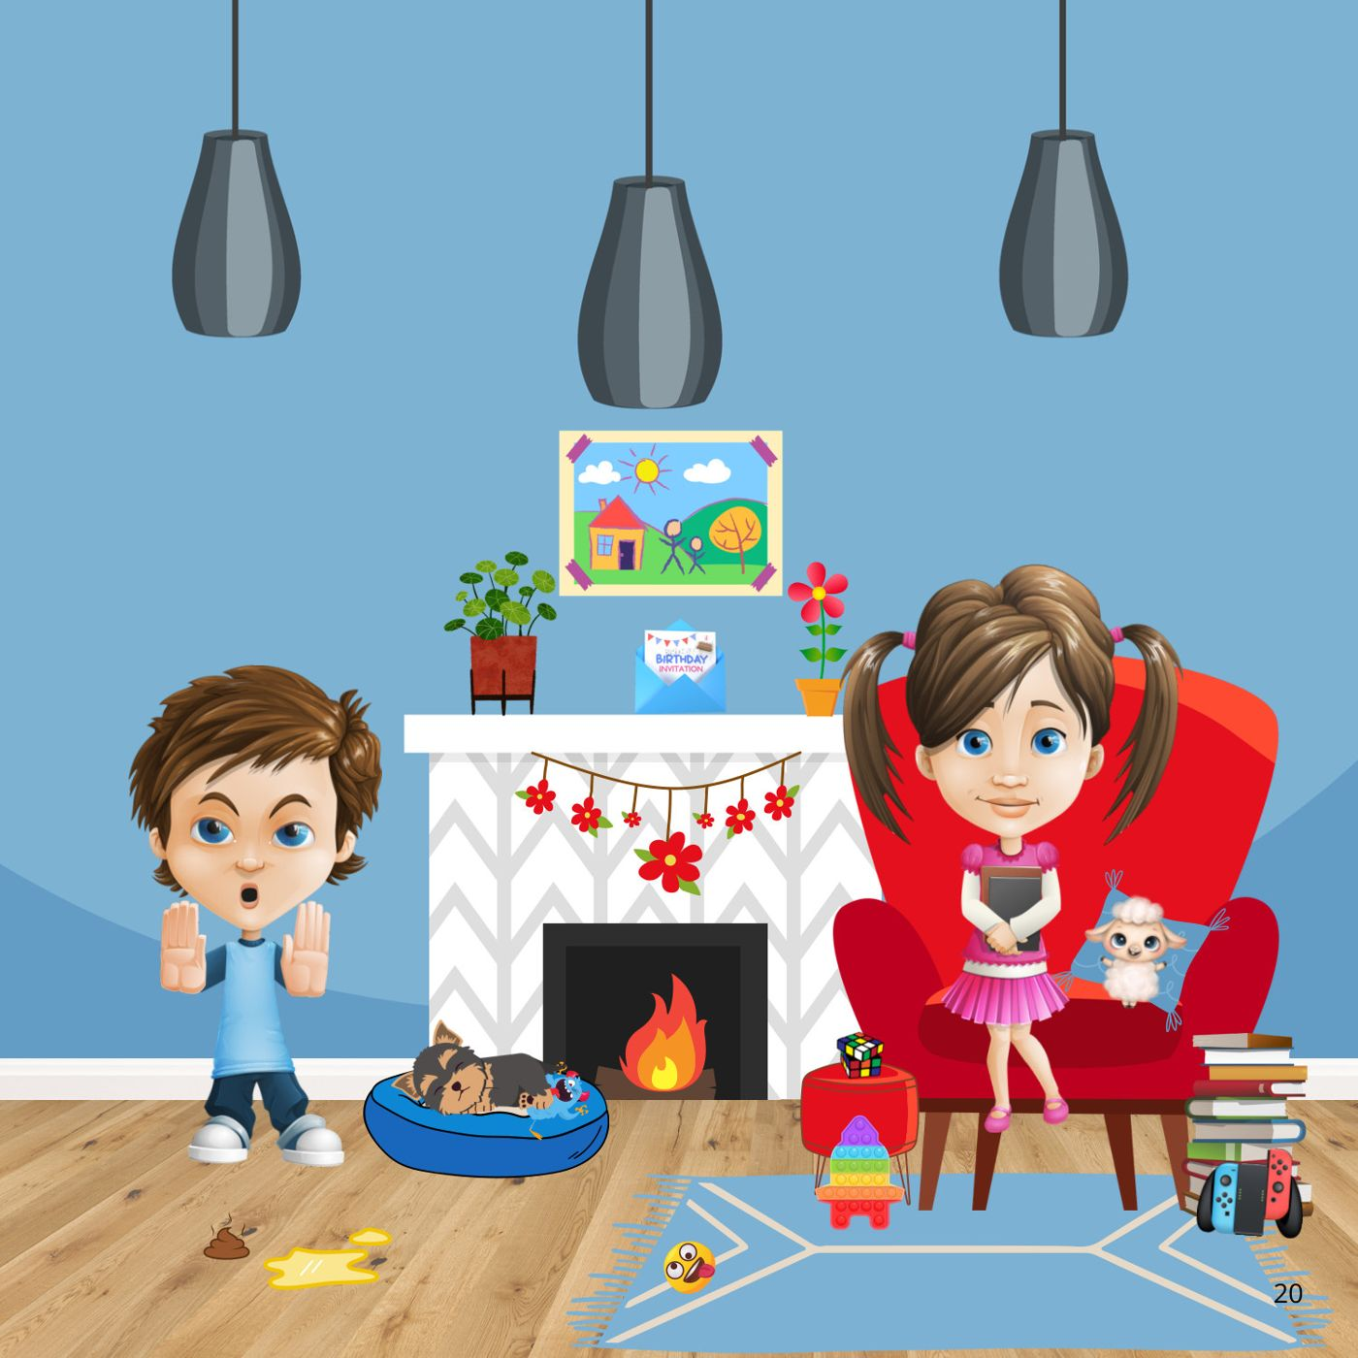
Notes:
Book page 20.

Slide 22
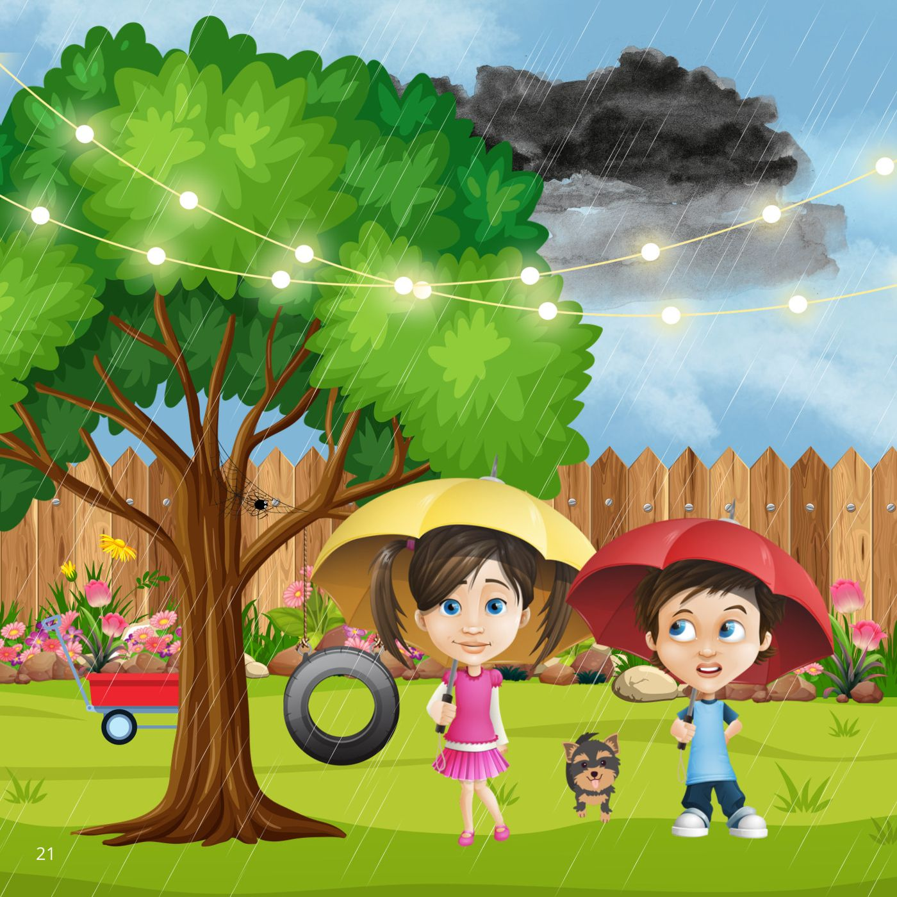
Notes:
Book page 21.

Slide 23
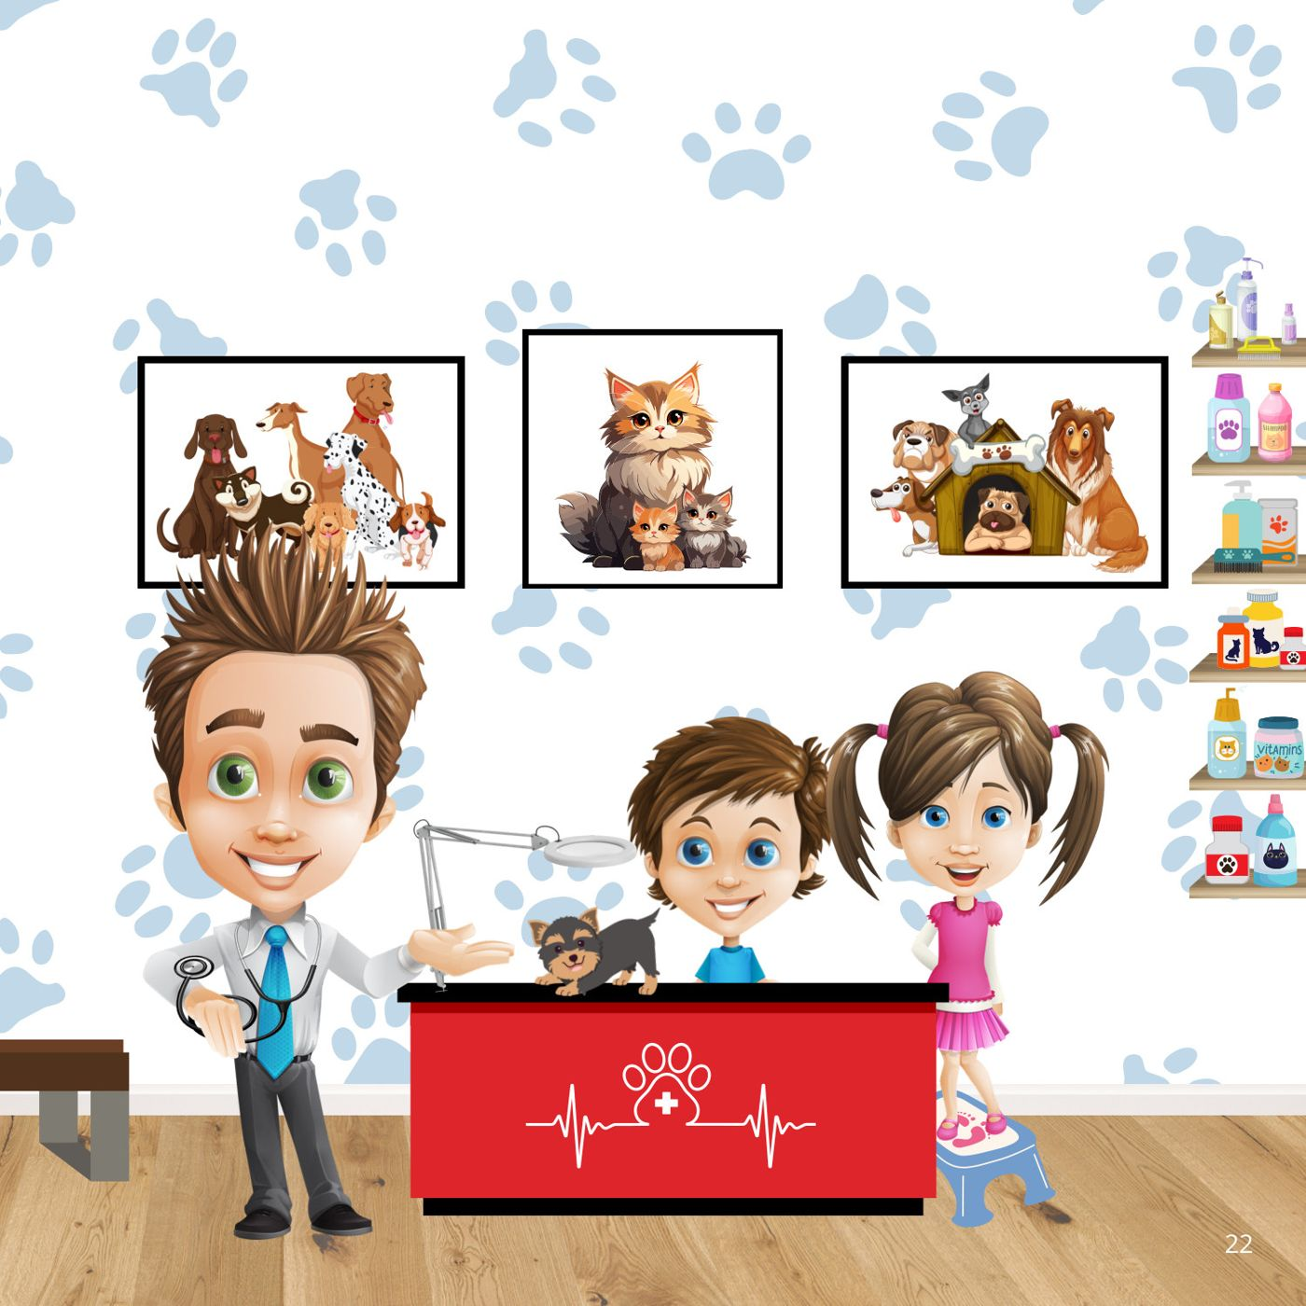
Notes:
Book page 22.

Slide 24
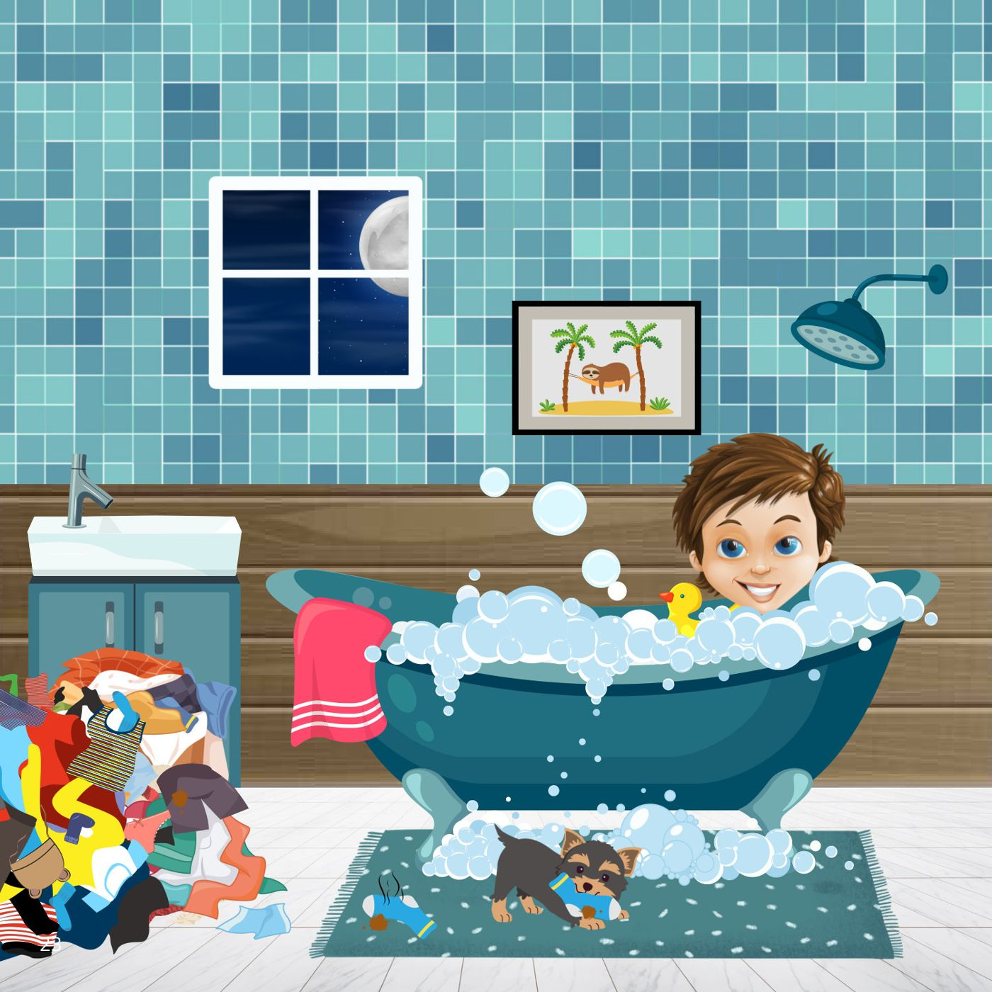
Notes:
Book page 23.

Slide 25

Notes:
Book page 24.

Slide 26
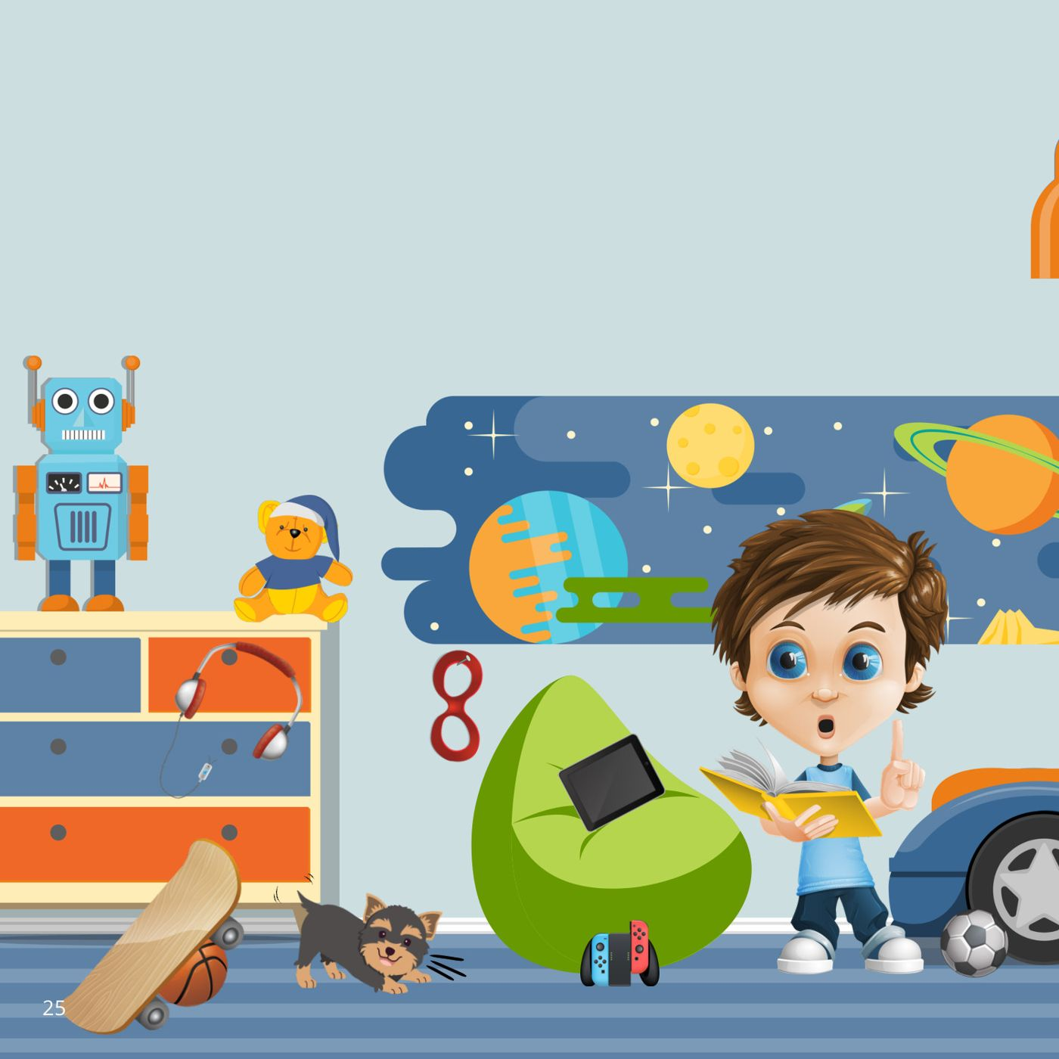
Notes:
Book page 25.

Slide 27
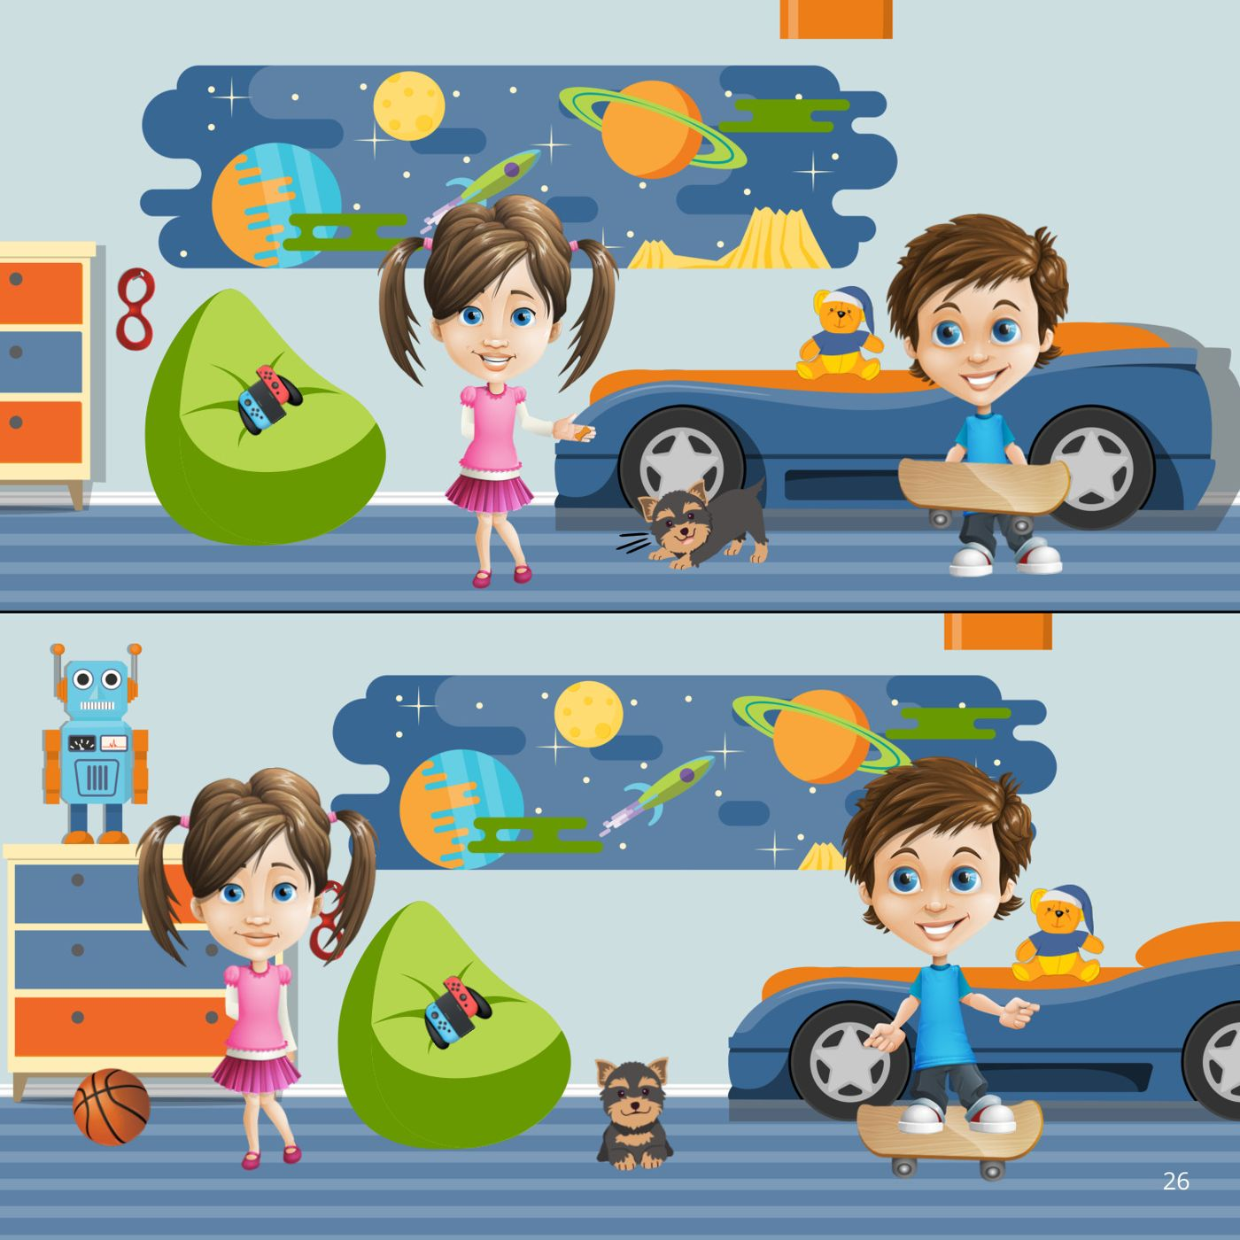
Notes:
Book page 26.

Slide 28
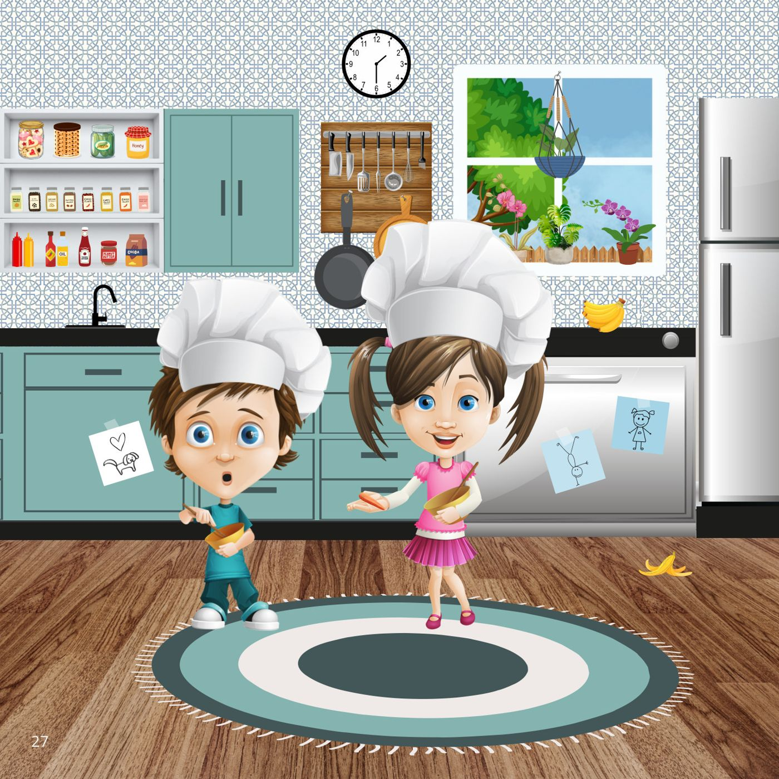
Notes:
Book page 27.

Slide 29
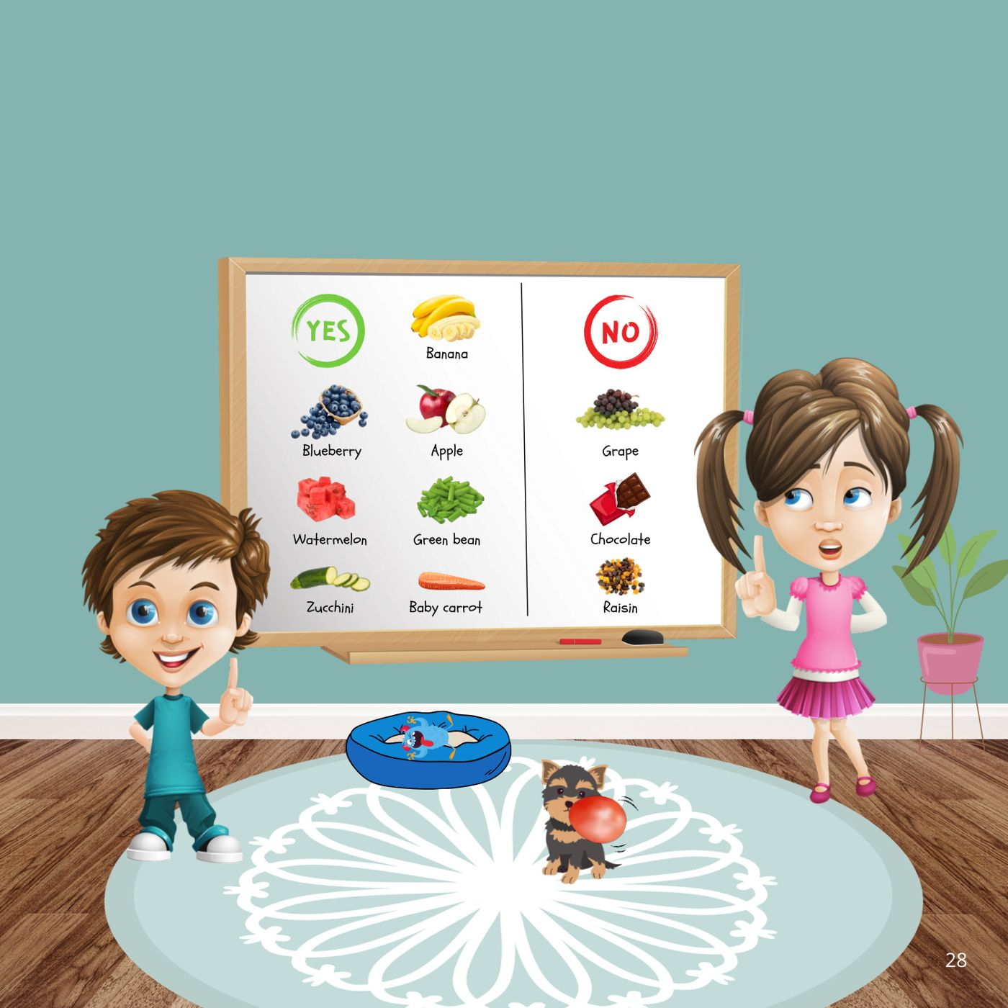
Notes:
Book page 28.

Slide 30
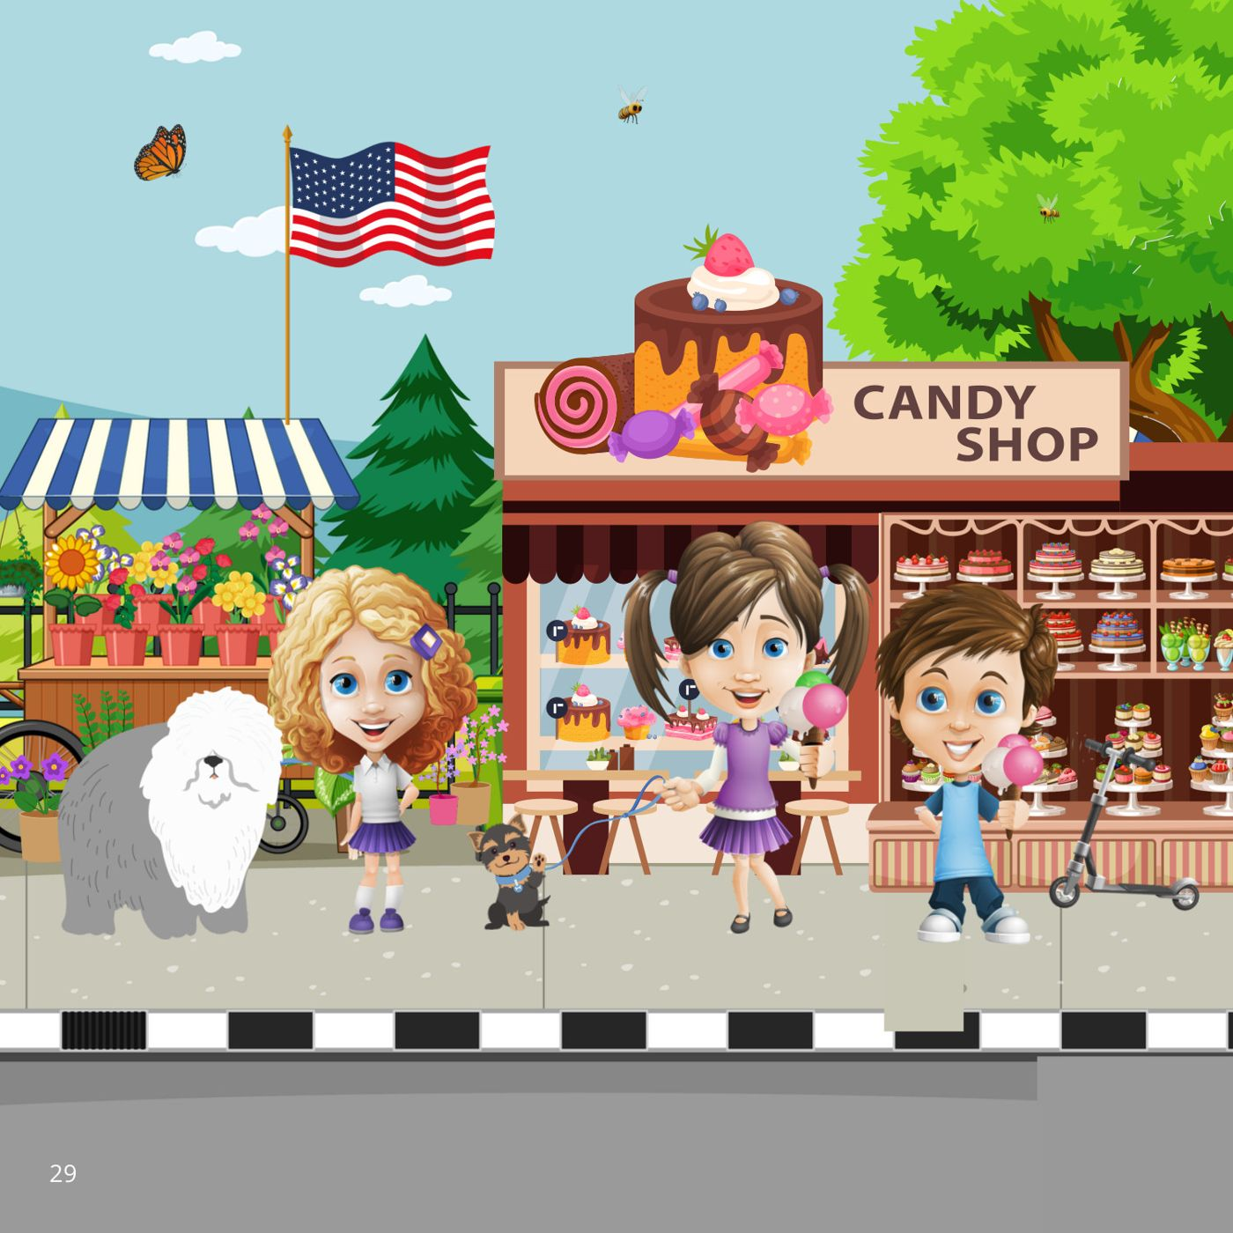
Notes:
Book page 29.

Slide 31
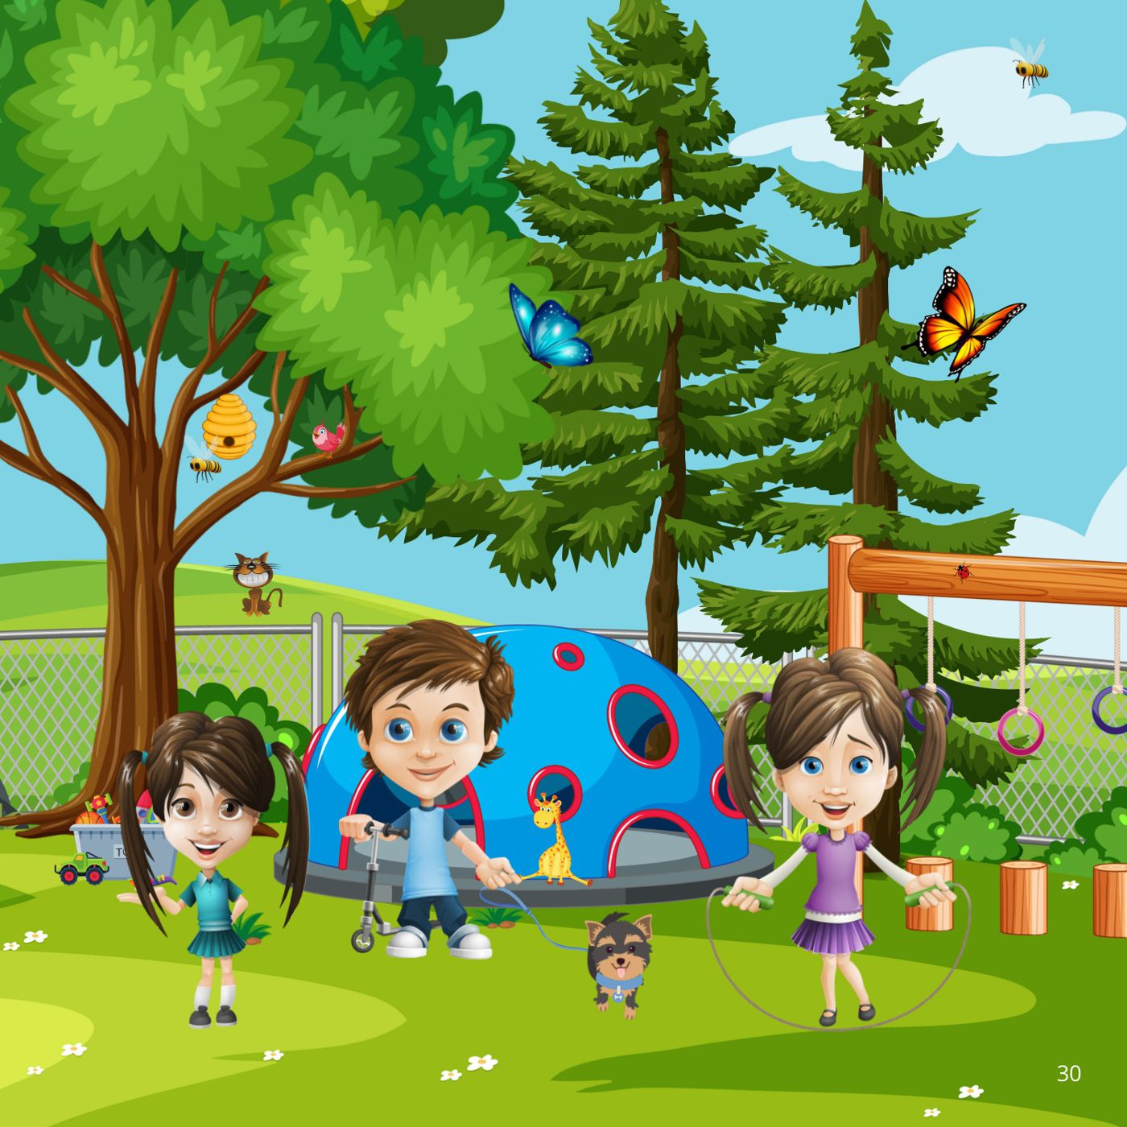
Notes:
Book page 30.

Slide 32
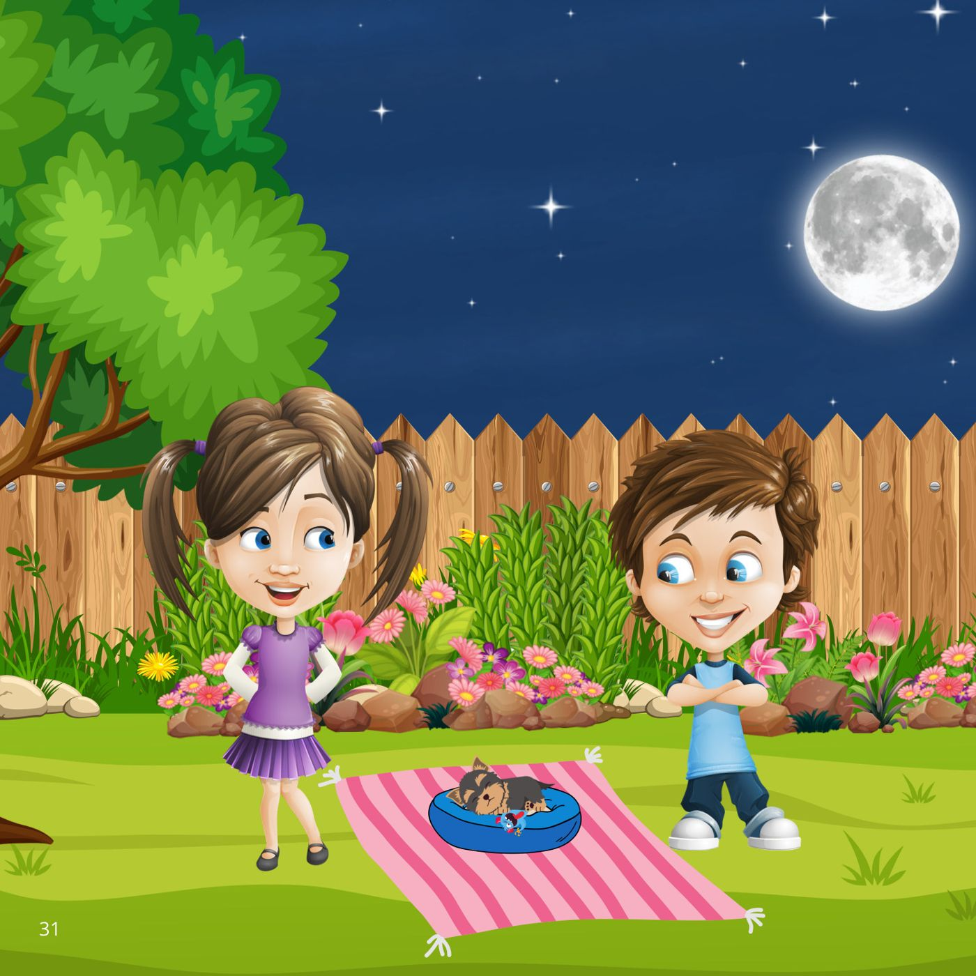
Notes:
Book page 31.

Slide 33

Notes:
Book page 32.

Slide 34
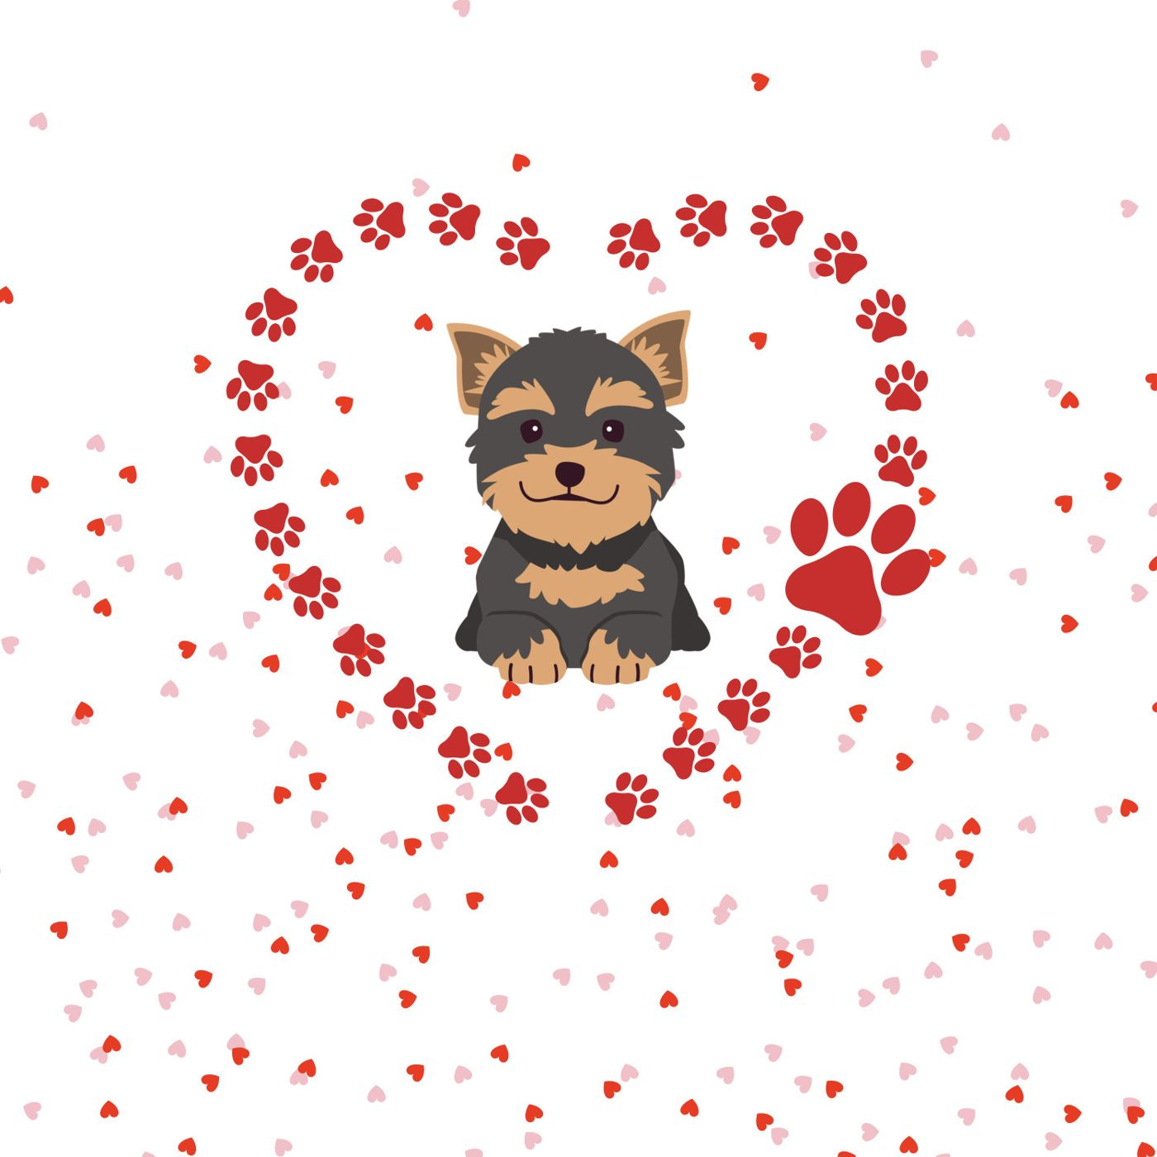
Notes:
End of the book.

Slide 35
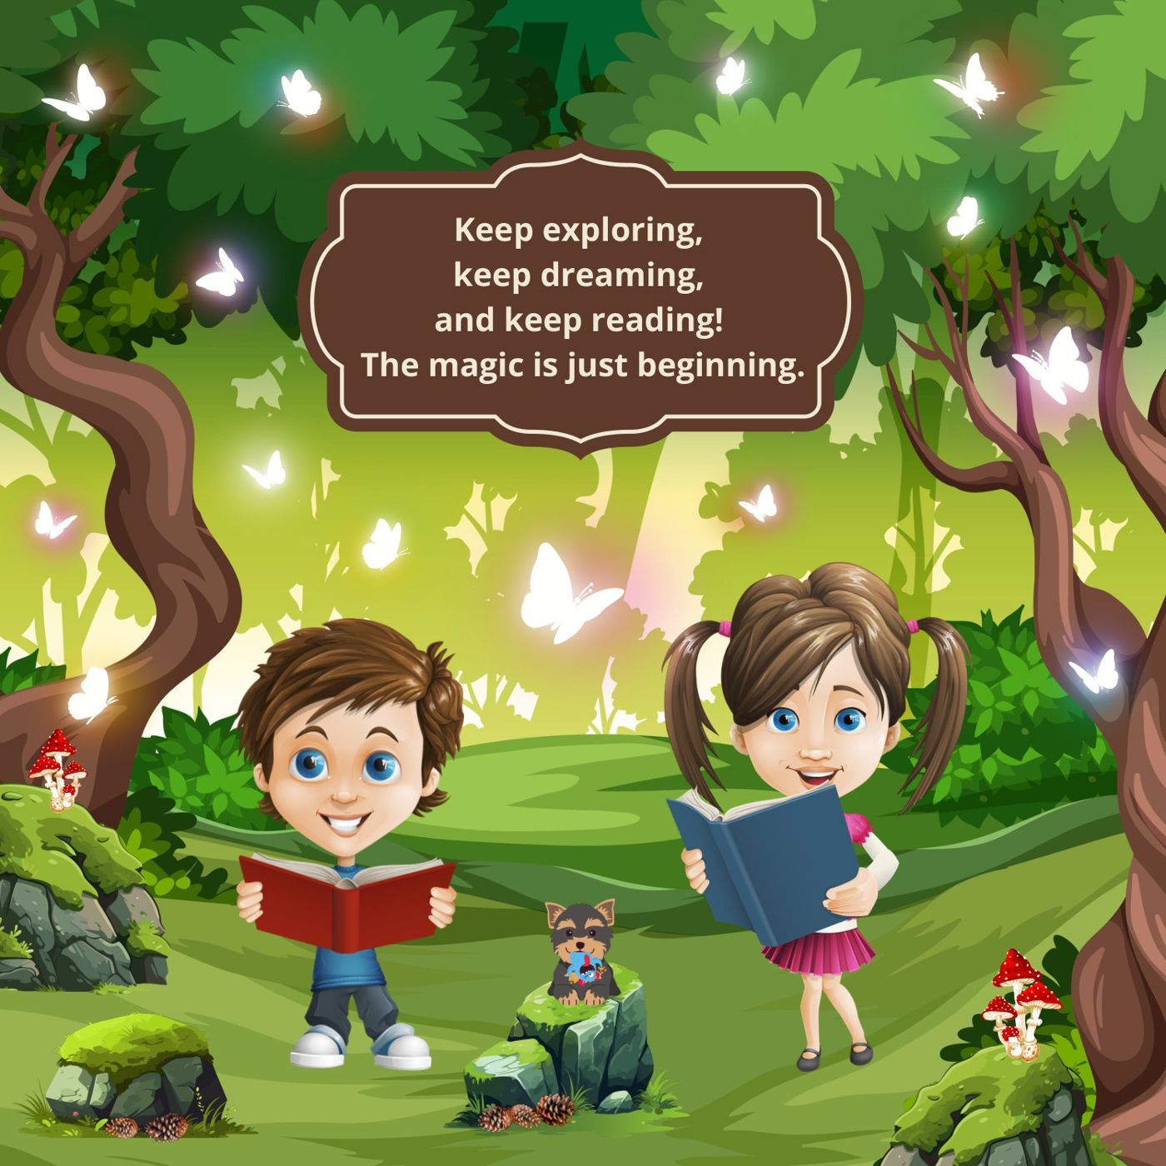
Notes:
End of the book.

